Slide 1
PrOPOSED TRAIL ROUTE
30th street corridor trail feasibility study
JULY 21st, 2026

Slide 2
Agenda
1
WHAT WE heard in round 2
2
Recommendations
3
Review draft PROPOSED ROUTE
4
ROUND 3 ENGAGEMENT

Slide 3
Project timeline
Phase | 2026 |  |  |  | 2027
 | Q1 | Q2 | Q3 | Q4 | Q1 | Q2
Engagement Round 1: Priorities & Existing Conditions
Engagement Round 2: Alternatives
Engagement Round 3: Preferred Alignment
Feasibility Study
30% Construction Plans

Slide 4
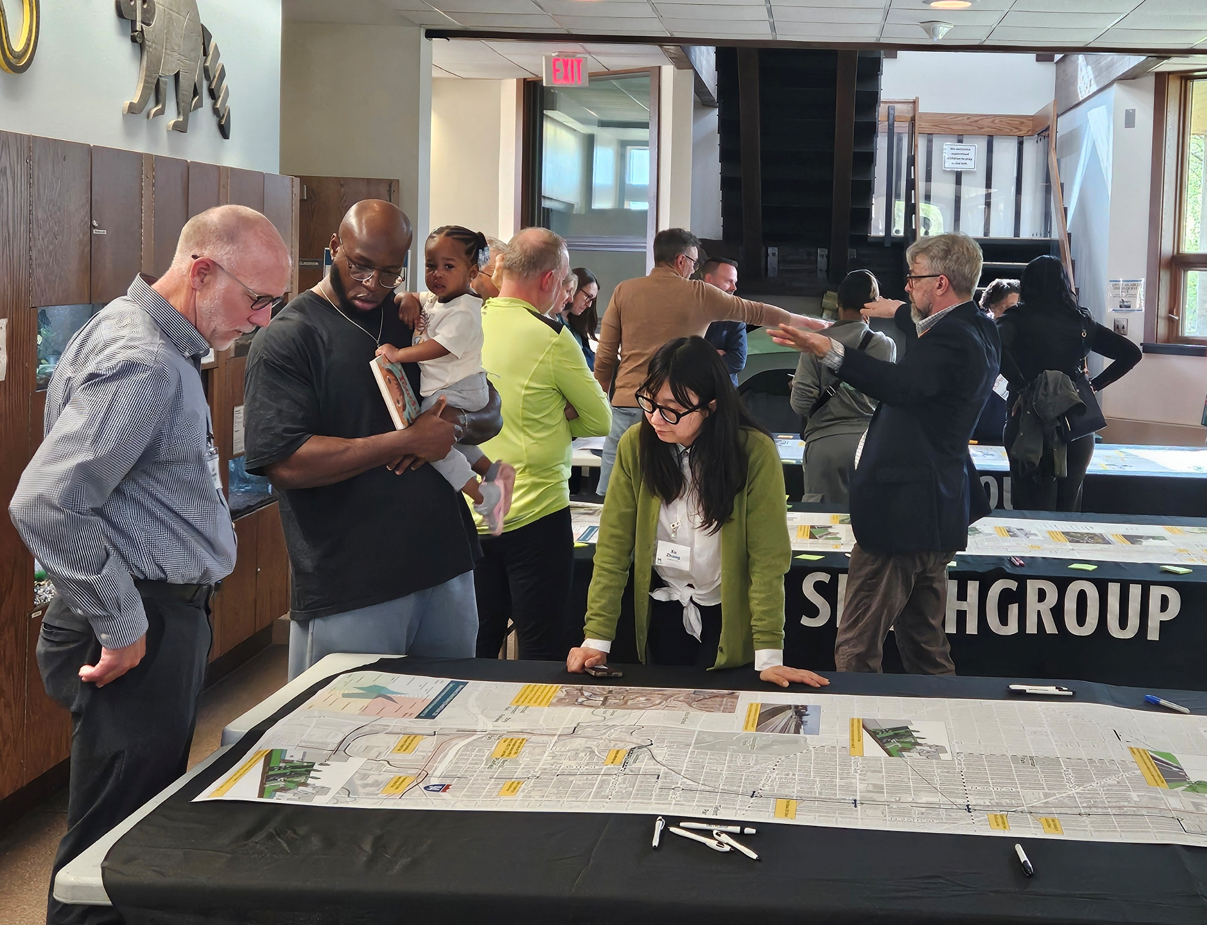
Round 2 engagement
March – May 2026
Goals:
  Share Round 1 engagement feedback
  Seek feedback on the trail alternatives
  Share initial evaluation criteria for the alternatives
Engagement Activities:
  Advisory committees (TAC and PAC)
  Stakeholder meetings
    30th Street Corridor Development Task Force
    Harley Davidson
    Molson Coors
    Brewers
    MMSD
  Public meeting (4/28)
  Online survey

Slide 5
Draft alternatives summary
Explore the Neighborhoods
Corridor Direct
Greenway Link
Most direct route
Most un-interrupted trail
Most number of new structures needed
Railroad approval challenging
Least accessible from neighborhoods
Links parks, rivers, and nature
Hybrid on-street and along rail
Direct connection to Oak Leaf and Beerline trails
Most circuitous route (least direct)
Floodplain regulatory approvals needed
No need for railroad approval
Most accessible to neighborhoods
Investments in safer streets
Most at-grade street crossings
Feels least like a trail

Slide 6
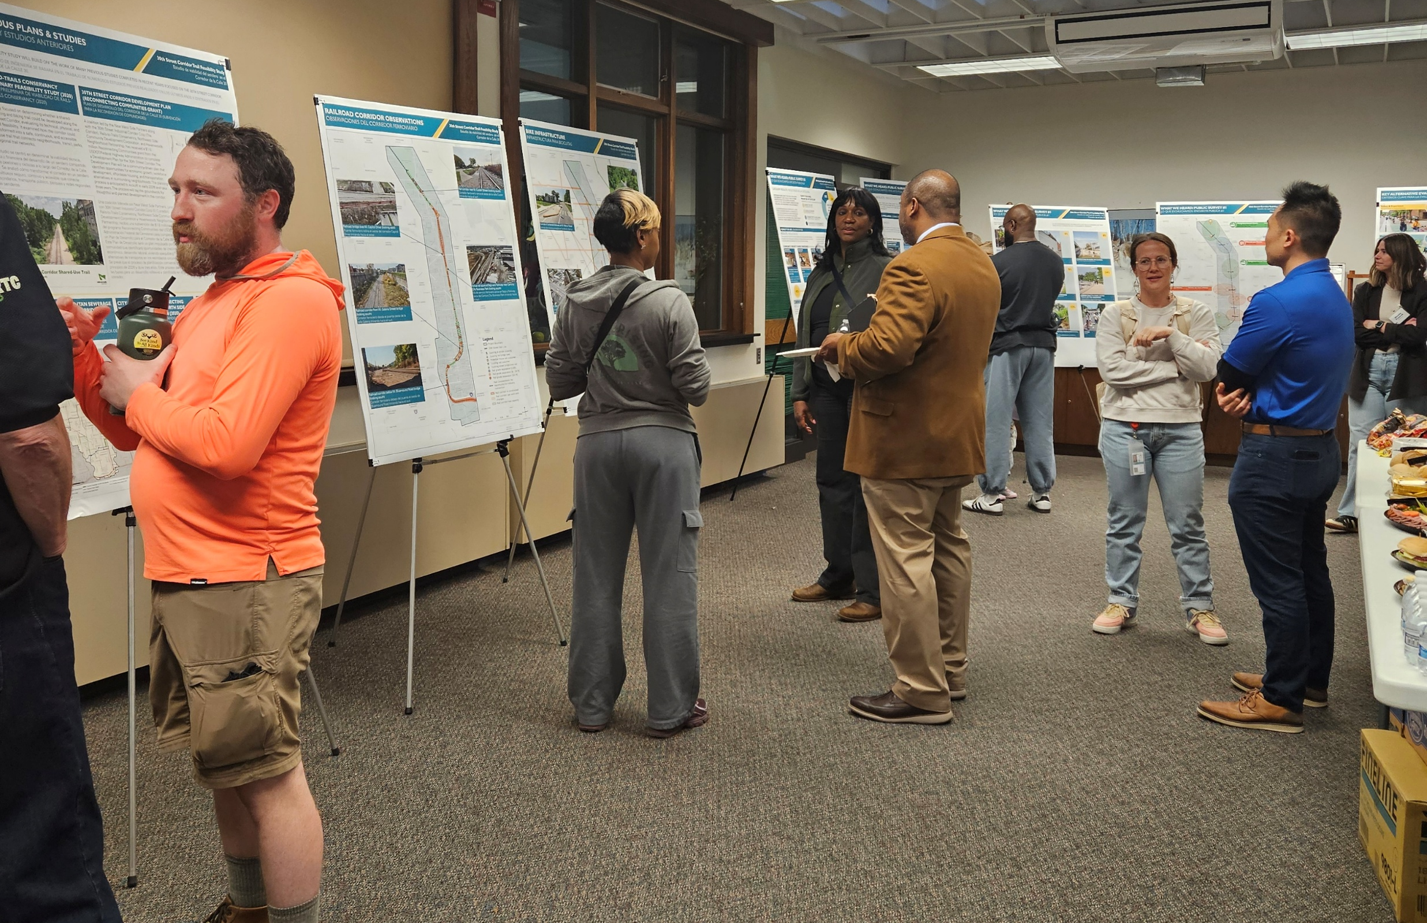
Round 2 by the numbers
38
Public meeting attendees
245
Survey responses
262 is the total number of roll plot and interactive map location points.
161 is the number of online survey responses plus one hard copy

Slide 7
Survey results
Overall alternative preference
44%
9%
11%
36%

Slide 8
Survey results
Corridor Direct favorite features

Slide 9
Survey results
Greenway Link favorite features

Slide 10
Survey results
Explore the Neighborhoods favorite features

Slide 11
Survey results
Combined favorite features from all three alternatives

Slide 12
What we heard
PUBLIC MEETING AND ONLINE SURVEY
45%
OF THE COMMENTS MENTION:
21%
OF THE COMMENTS MENTION:
Connection to existing/future trails
Safety from vehicle traffic
“For me the number one concern is safety as a biker or walker. Reducing at-grade street crossing is vital.”
“I don’t consider on-street routes…to actually qualify as ‘trails.’”
“Do everything possible to physically separate bikes from cars. Bike lanes that are just painted on are dangerous.”
“I am in favor of connecting to as many existing trails as possible, like the Beerline. A network of car free routes around the city is the dream.”
19%
OF THE COMMENTS MENTION:
Trails should serve transportation & recreation
“Prioritize helping connect Milwaukeeans to a variety of assets along the corridor — not just a commute.”
“I prefer bike trails that can be used for getting around to work and errands rather than trails that are purely recreational.”
24%
OF THE COMMENTS MENTION:
Wayfinding, access, & directness
“Any off rail should/has to be well marked and ‘branded’ to not lose riders along the way.”
“Making it as easy as possible to jump on and off the trail would convince more people to use it.”
12%
OF THE COMMENTS MENTION:
Personal safety, maintenance & operations
20%
OF THE COMMENTS MENTION:
“Consider what is likely to be least costly to maintain.”
“[Corridor Direct] feels the least safe from citizens policing the route given you're down in that below grade 'canyon' along much of the corridor.”
Feasibility, railroad coordination
“…get permission from landowners feels like it may stall the project significantly.”

Slide 13
comments on the alternatives
Corridor Direct
Most direct and continuous route | “The trail needs to have the fewest street crossings and be continuous and easy to follow. The rail corridor does this the best.”
Feels most like a true trail | “Corridor Direct is a far superior trail option. It will provide a safe, true recreational space away from motor vehicle traffic.” … “I do not think building this on the city streets would be a safe or enjoyable experience or make a true trail that this part of town needs.”
Good for commuting and recreation | “It would create a very strong backbone for the city to then build off of with other connections to neighborhoods and green space.”
Easier wayfinding | “Having the route be as direct as possible would lead to less confusion along the ride.”
Pros
Railroad coordination and land access, and cost | “Direct looks like the most expensive, permission acquisitional, and time consuming alternative.” “It concerns me that the City has been told repeatedly that the railroad is not interested in selling or leasing their land.” “Too many elevated bridges and bikeways in CD plan”
Limited neighborhood access | “I cannot tell where you can get on or off the trail on the Corridor Direct concept.” “Corridor Direct is my favorite but it needs enough ramps to make getting on and off easy.”
Elevated trail concerns | “I also don't like the elevated trail segments - they feel unfriendly and expensive as drawn.”
Cons

Slide 14
comments on the alternatives
Greenway Link
Connects to parks, waterways, and green spaces | “I like the Greenway Trail best because of the connections to parks and green spaces.” “There’s so much research backing up the benefits of spending time in nature, and this would provide safe connections to many green spaces.”
May be more feasible | “The Greenway Link is the best overall. I don’t see the Corridor Direct option being very feasible with the amount of railroad cooperation and the infrastructure needed.”
Good trail-network connections | “…links to the Oak Leaf Trail, Beerline Trail, Lincoln Creek, Hank Aaron State Trail, and future extensions..”
More active and visible | “I would lean heavily into the Greenway Link…you’re in busy parks…and a more natural experience.”
Pros
Less direct and includes on-street segments | “Greenway Link has some positive true trail features, but also not-great on-street segments.” “Don’t go way out of the way.”
Less tied to the rail-with-trail vision | “Seems like the Greenway and Explore the Neighborhoods concepts have little to do with the 30th Street Industrial Corridor and rail line.”
Confusing wayfinding | “Any off rail should/has to be well marked and ‘branded’ to not lose riders along the way.”
Cons

Slide 15
comments on the alternatives
Explore the Neighborhoods
Connects directly to neighborhoods | “…a big opportunity to meaningfully integrate with existing state and city plans for bikeways and create connections with the transit system.”
May be more feasible | “Public right of way guarantees SOMETHING gets built.” “I can especially appreciate that #3 might be easiest to do given that you don’t need RR permission.”
Build on existing city bike plans | “It may also avoid redundancies in bikeway travel, given the other bikeway plans.”
Increases visibility of biking | “It helps increase the visibility of cycling across the city as well.”
Support transit and commuting | “I think the most important opportunity for this project is to make bicycles a more practical option for transit in Milwaukee.”
Pros
Less safe & comfortable | “Explore neighborhoods has too many interactions with vehicular traffic and thus higher risk of collision.” ..“The Explore the Neighborhoods option is in my mind not safety conscious enough.” .. “I don’t consider on-street routes…to actually qualify as ‘trails.’” .. “Bike lanes that are just painted on are dangerous, drivers ignore them.”
Confusing wayfinding | “The Explore the Neighborhoods concept is good because it develops city streets, but the route feels convoluted.”
Cons

Slide 16

Combining alternatives
“This CANNOT be an either/or proposition. The trail must be the ‘spine’…AND it must connect to communities.”
“I like elements of each of the 3 alternatives and I envision that ultimately the 30th St project should incorporate the best that each alternative has to offer.”
“Prefer a combination of the Greenway Link and the Corridor Direct plan.”
“The trail needs to have the fewest street crossings and be continuous and easy to follow.”

Slide 17
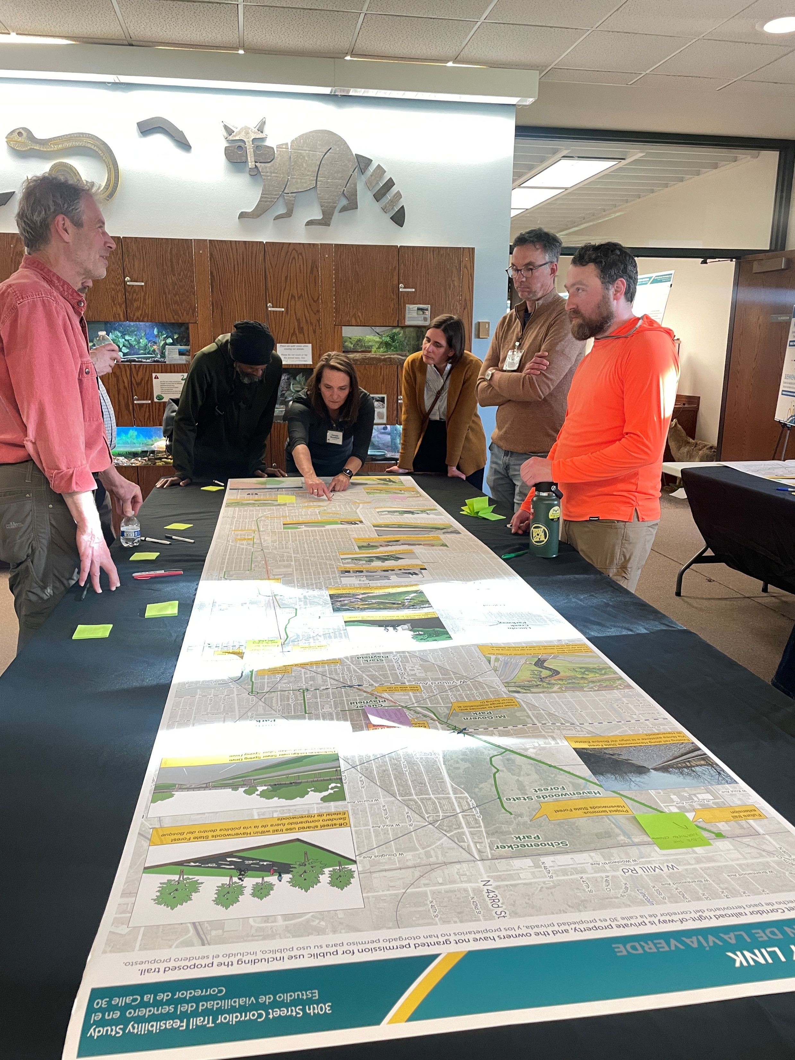
Round 2 summary
Corridor Direct was most favored by survey respondents and key stakeholders, but more than a third preferred Greenway Link
  Most continuous uninterrupted trail – “feels” more like a trail
  No at-grade crossings of major streets
Greenway Link and Explore the Neighborhoods each have elements that the community like
  Connections to parks and green spaces
  Segments along Menomonee River
  Connections to neighborhoods and easier access
  Safety improvements on City streets
Feasibility concerns remain regarding Corridor Direct
  Permission for use of the rail corridor as a barrier
  Cost of structures seen as potentially delaying the trail
  Flyovers may be seen as uncomfortable or unsafe if too long

Slide 18
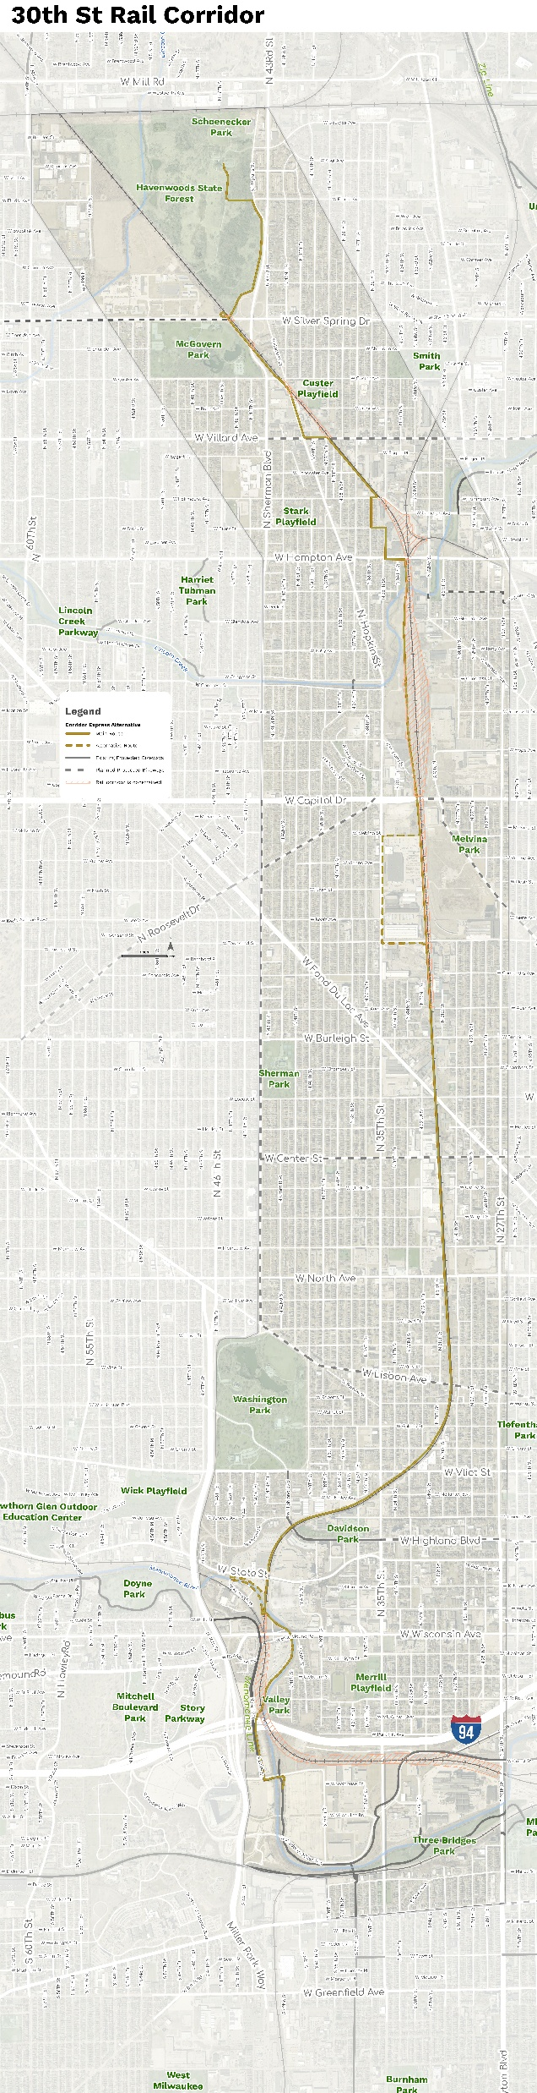
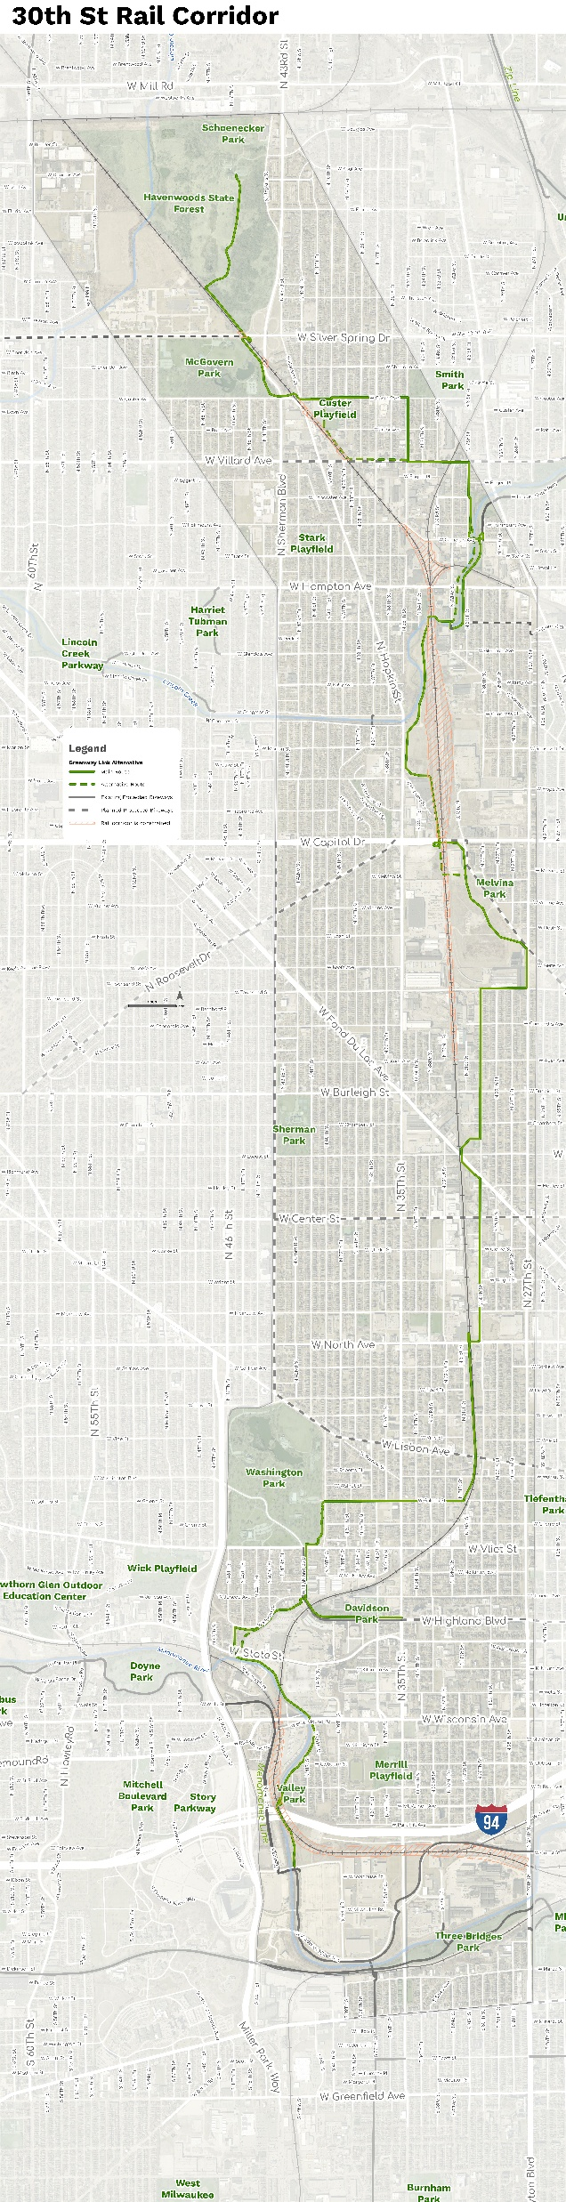
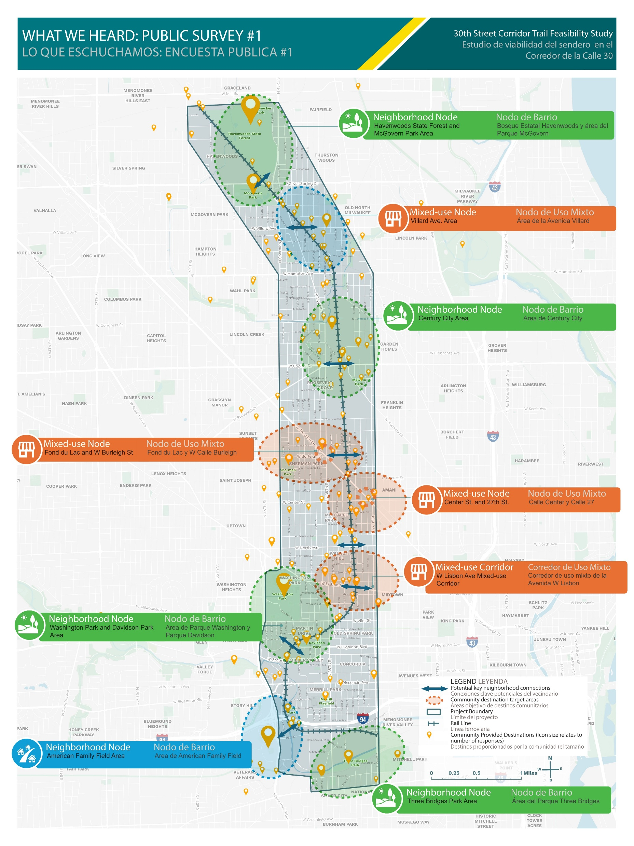
Recommendations
Consolidating to one preferred alternative
Corridor Direct
Greenway Link
Explore the Neighborhoods
  Use Corridor Direct as the “base”
  Uninterrupted trail
  Bridges or underpasses at all major streets
  Flyovers to avoid major rail infrastructure (where feasible), but limit length for cost and comfort
  Limit railroad ROW usage where possible
  Incorporate best parts of Greenway Link, (connect to water, green space, other trails)
  Incorporate best parts of Explore the Neighborhoods (safe/easy neighborhood access, safer streets)
  Entry to Havenwoods & connection to McGovern Park
  Connections to community destinations
  Regular access ramps
  Safe and intuitive routes to connect neighborhoods to the trail
  Traffic calming and protected bike infrastructure
  Lincoln Creek & West Basin segment, connections to Oak Leaf & Beerline trails
  Menomonee River segment (east side of river)
  Use spurs to connect to other parks and existing trails

Slide 19
discussion
Thank you!
Questions?
Contact Danny Park
daniel.park@milwaukeecountywi.gov

Slide 20
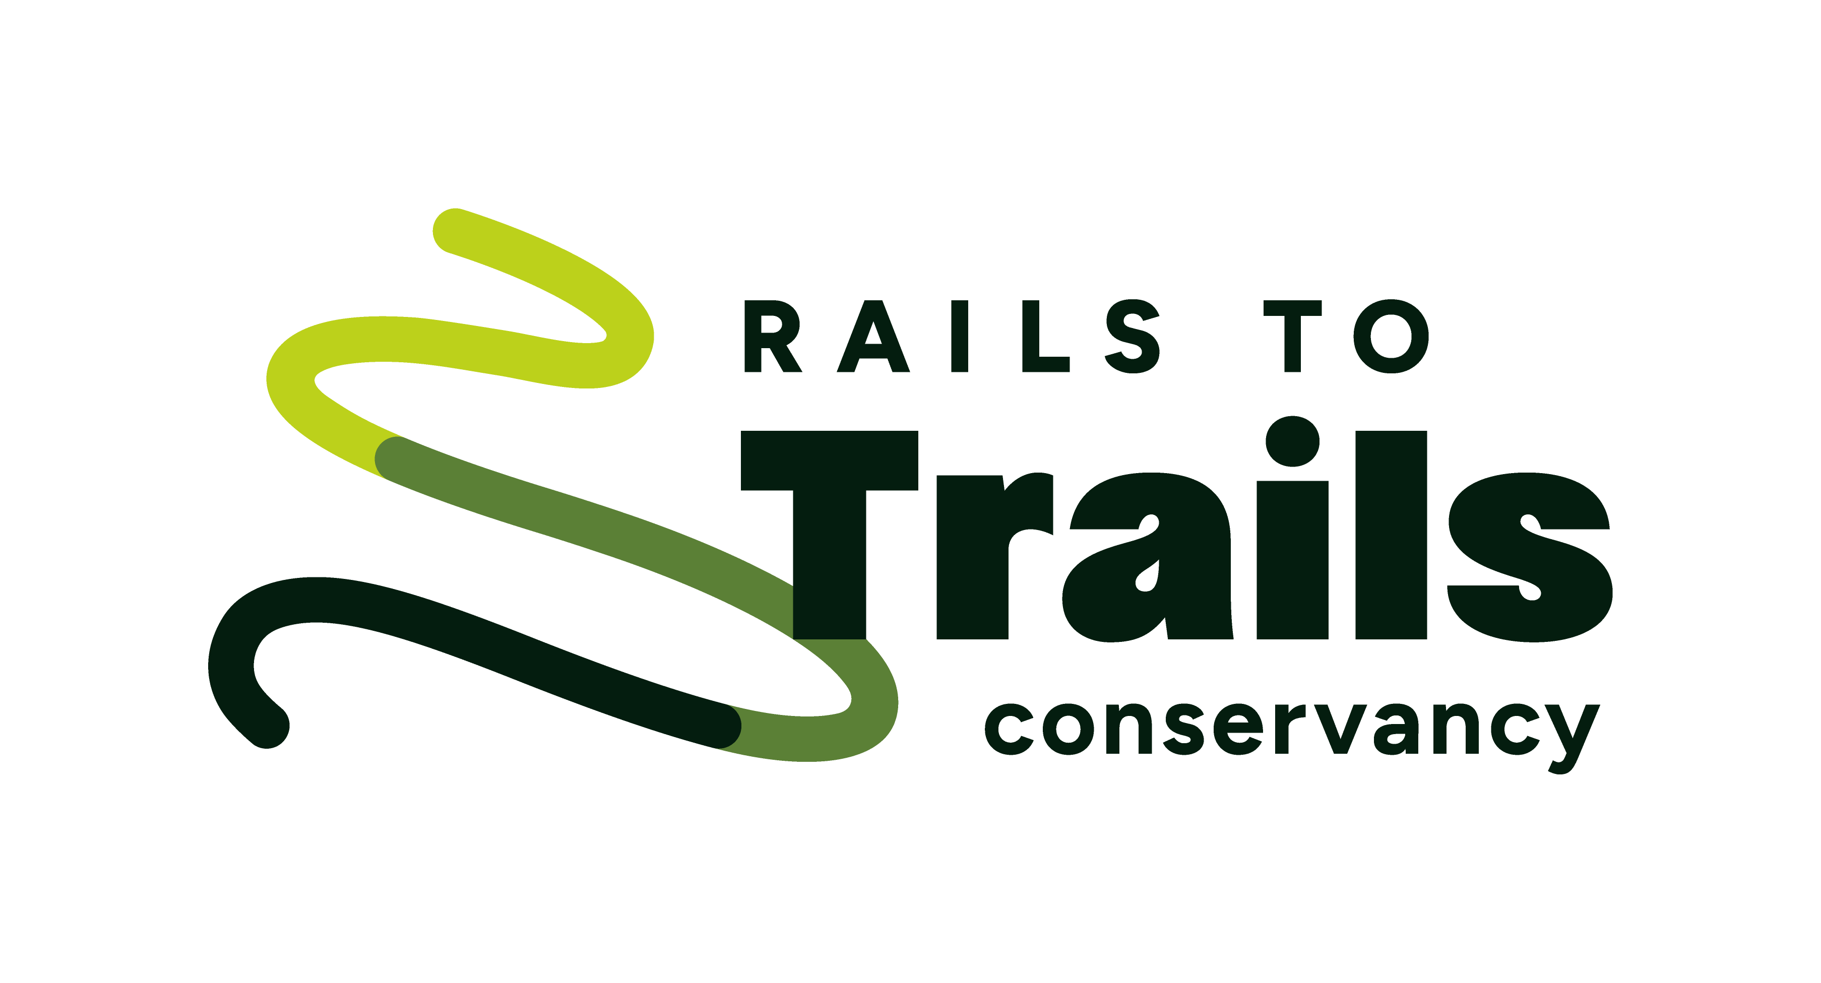



introductions
Project Team
CORE TEAM
Danny Park, Project Manager
Milwaukee Co. DOT
Mike Amsden, Transportation Planning Manager
City of Milwaukee DPW
Willie Karidis, Project Director
Rails to Trails / Route of the Badger
CONSULTANT TEAM
Cassie Goodwin, Project Manager
SmithGroup (Lead Consultant)
Kapur
Public Engagement
Dr. Joan Prince
Public Engagement
Benesch
Railroad Analysis & Design
Michael Baker
Streets, Bridges & Trail
OES
Environmental & Basemapping
Chronicle Heritage
Historical & Archaeological
Notes:
The Consultant team is led by SmithGroup and includes 6 other consulting groups, including Kapur and Dr. Joan Prince who are here today and are leading public engagement. We report directly to Milwaukee County DOT, and the City and Rails to Trails are partners on the project.

Slide 21
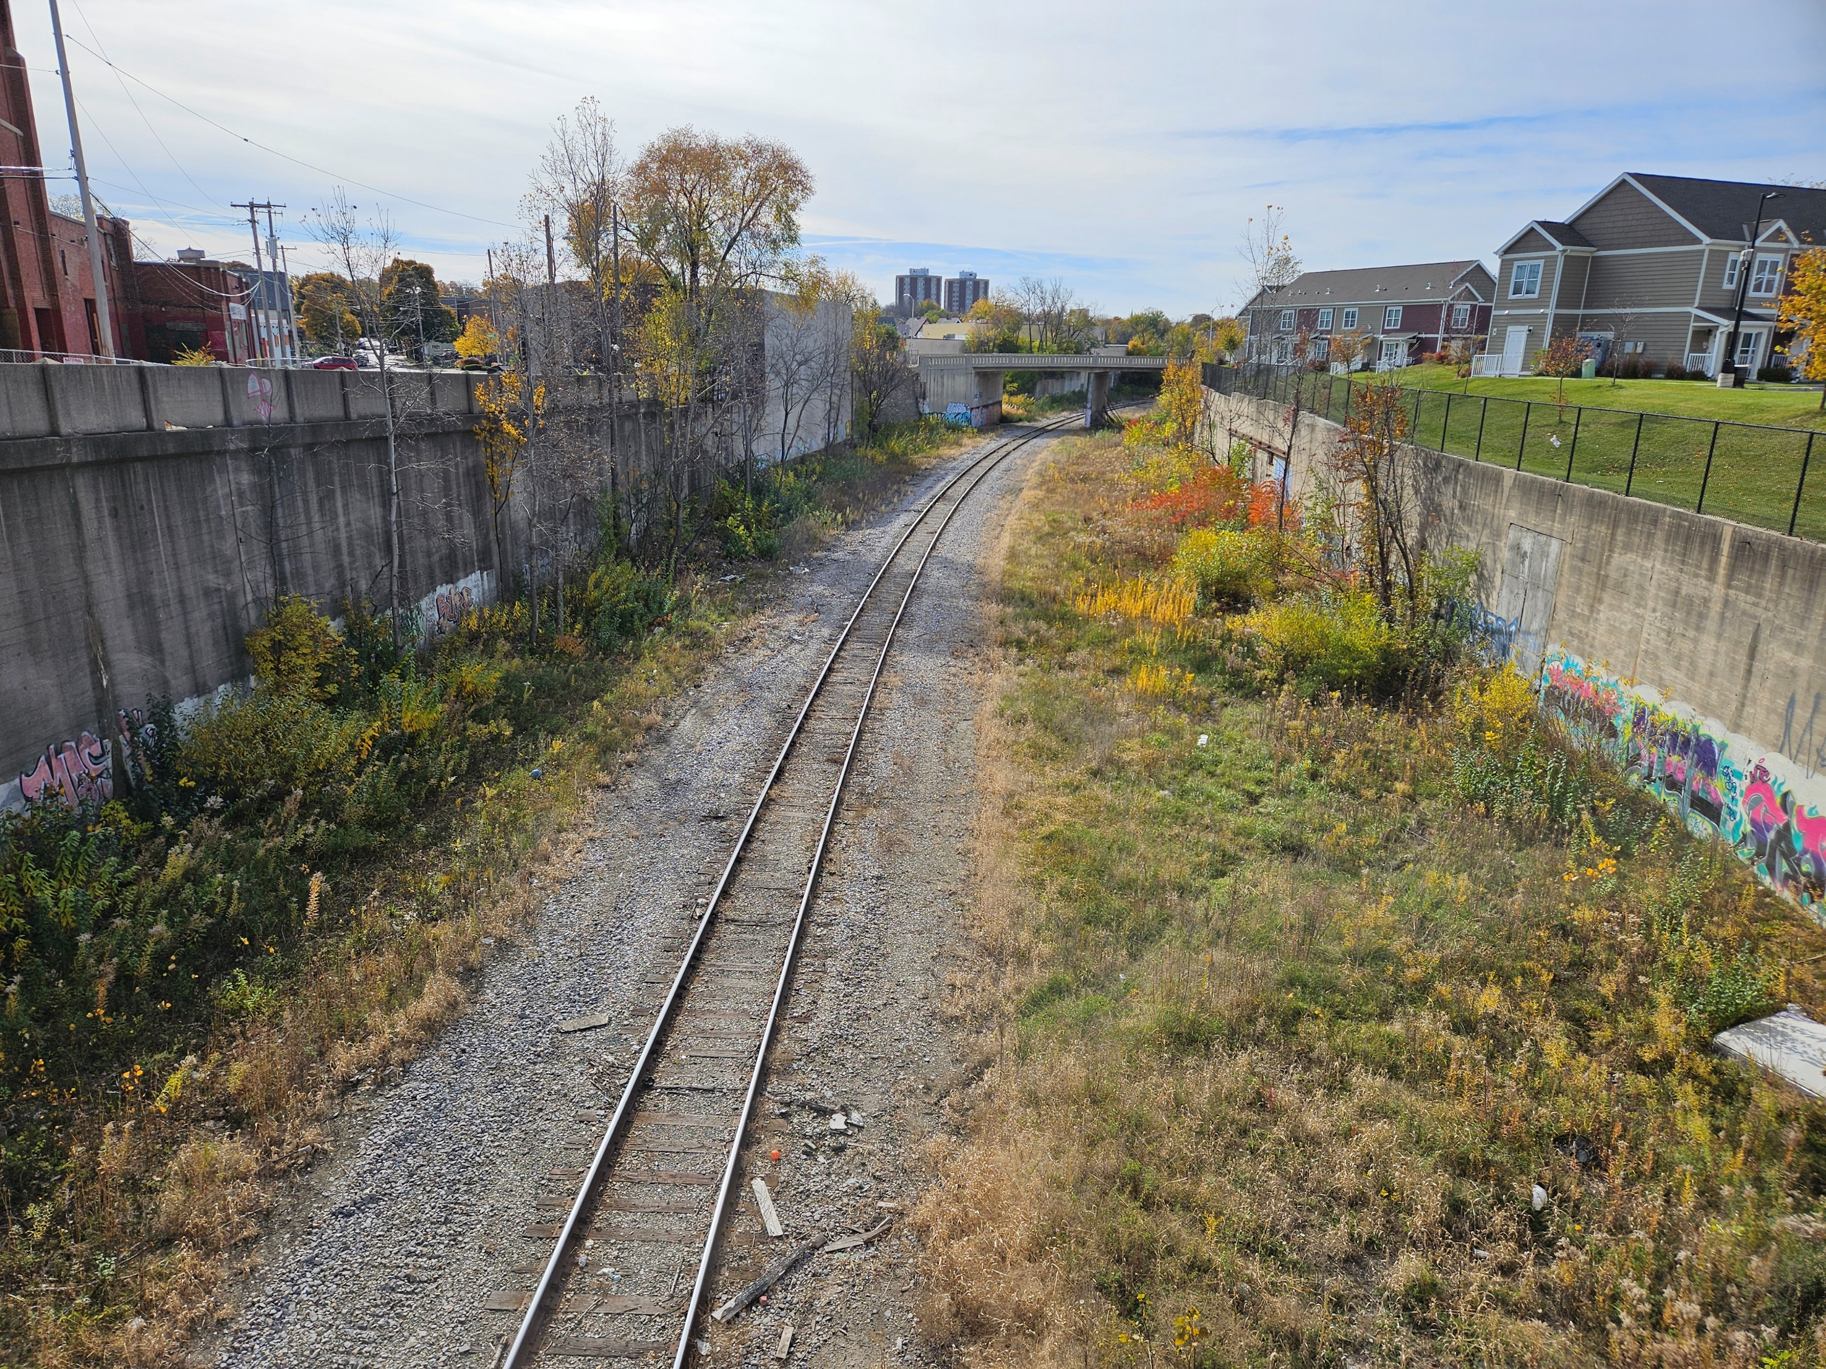
Project overview
Feasibility Study Objectives
Evaluate alternative trail routes within the rail corridor and on neighborhood streets
Engage the community to learn how new bicycle and pedestrian connections would serve local needs
Coordinate with the railroad to maintain rail support for local industry and jobs
Set the stage for future construction phases by developing preliminary engineering plans
Notes:
Objectives for the feasibility study include:

Slide 22
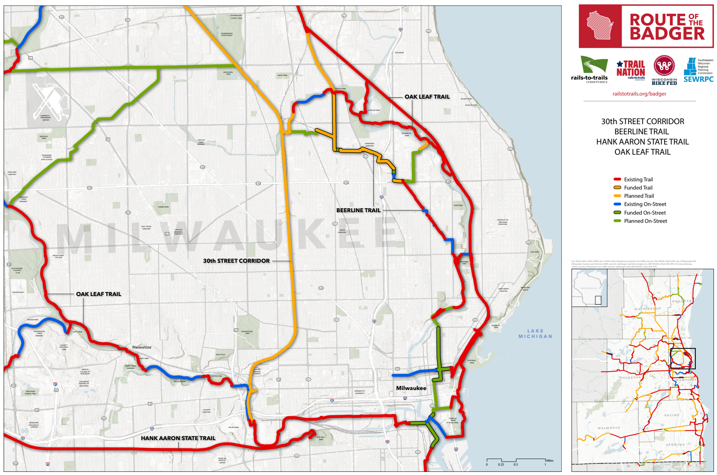
Project overview
Context: Route of the Badger
7-county area focused in Southeastern Wisconsin
Vision of a 700-mile network of trails and on-street bike facilities
30th Street Corridor Trail would complete the “Milwaukee Loop” – a 18-mile off-street loop around the city
Connects the Hank Aaron State Trail, Oak Leaf Trail, and Beerline Trail
Notes:
You are all likely very familiar with the Route of the Badger.

Slide 23
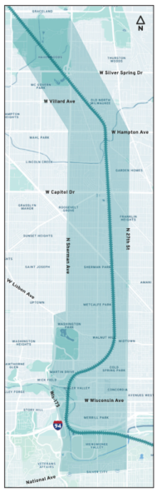
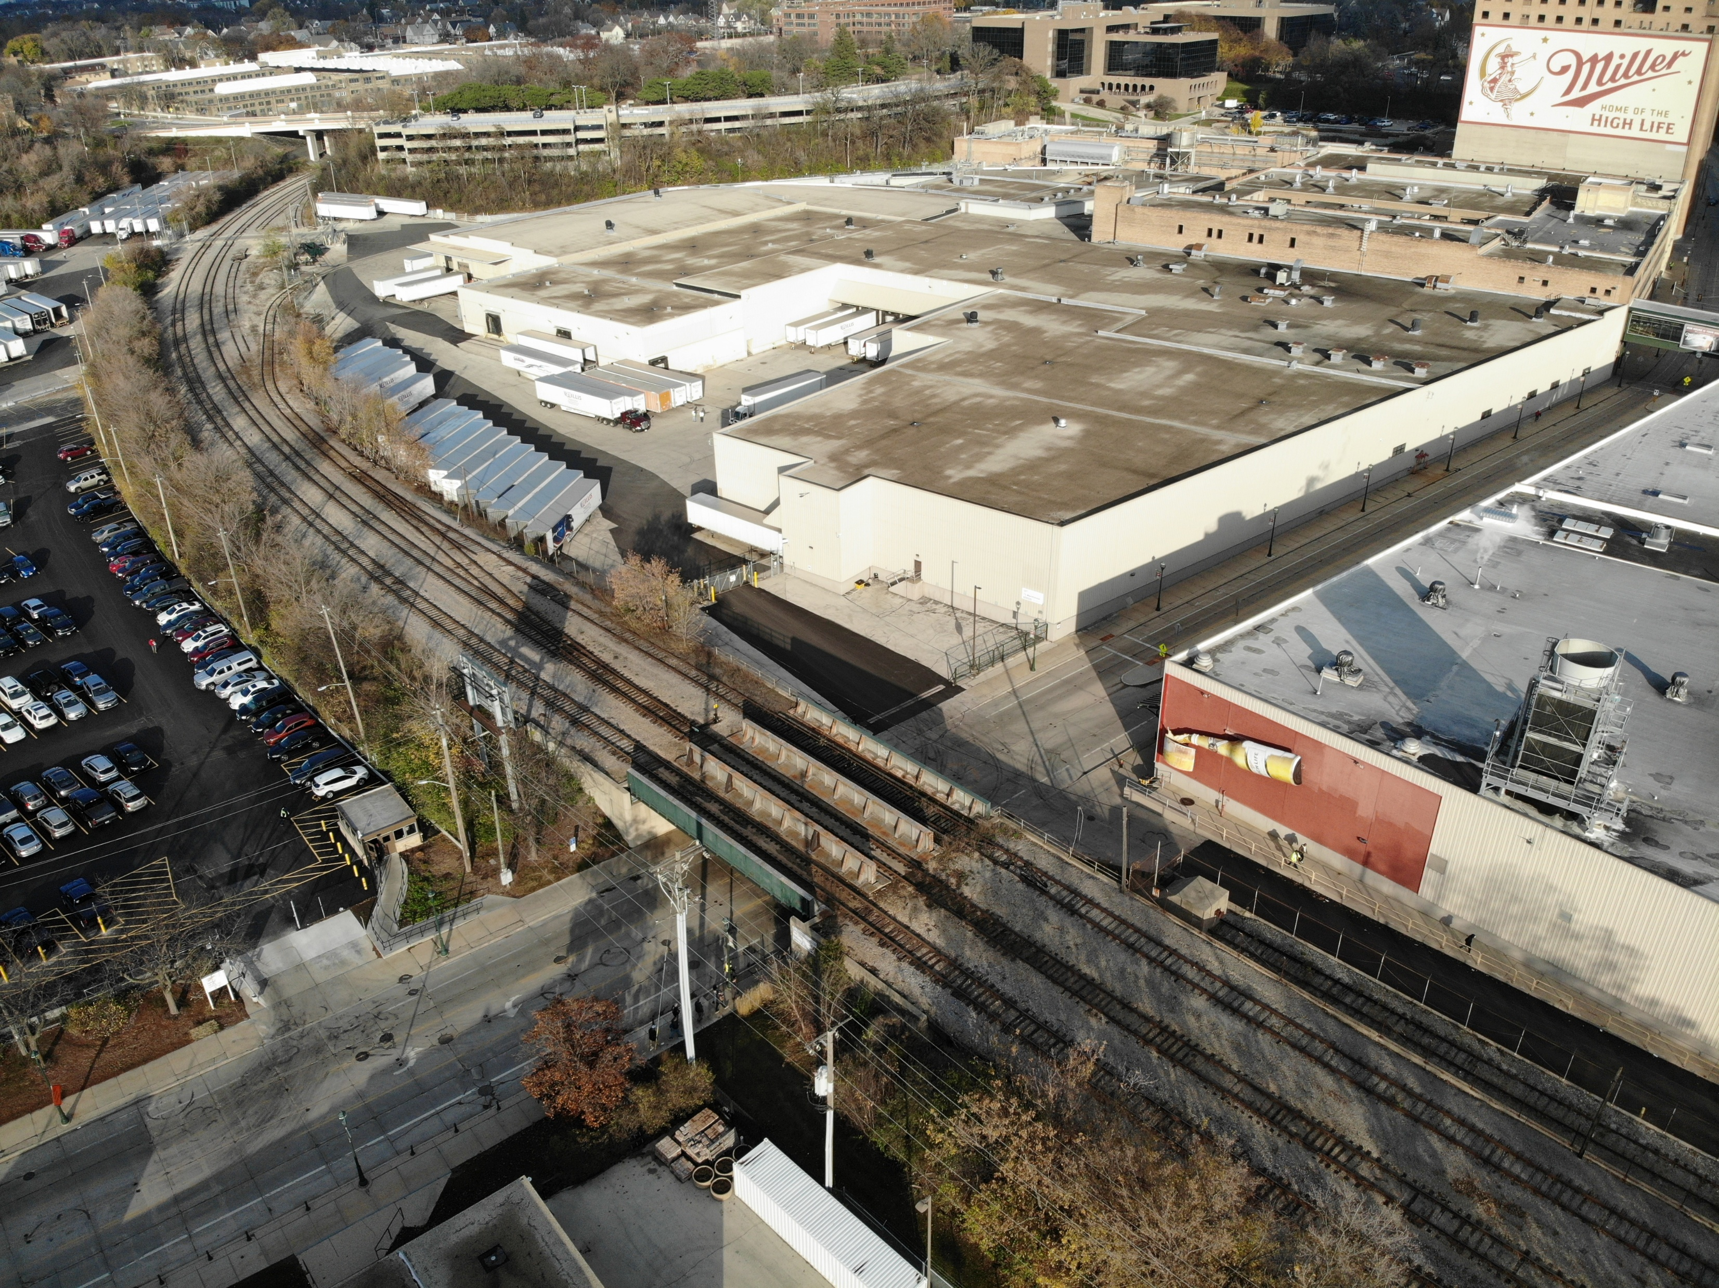
30th street corridor description
Approx. 7-mile corridor, Menomonee Valley to Havenwoods State Forest
Ownership: WisDOT, WATCO/Wisconsin Southern, Canadian Pacific (CP)
At-grade, above-grade and below-grade conditions
  9 railroad bridges over City of Milwaukee streets
  11 City of Milwaukee bridges over rail
  One railroad underpass at I-94
  3 at-grade railroad crossings at City of Milwaukee streets
Rail ROW is typically 100-ft wide, mostly single-tracked

Slide 24
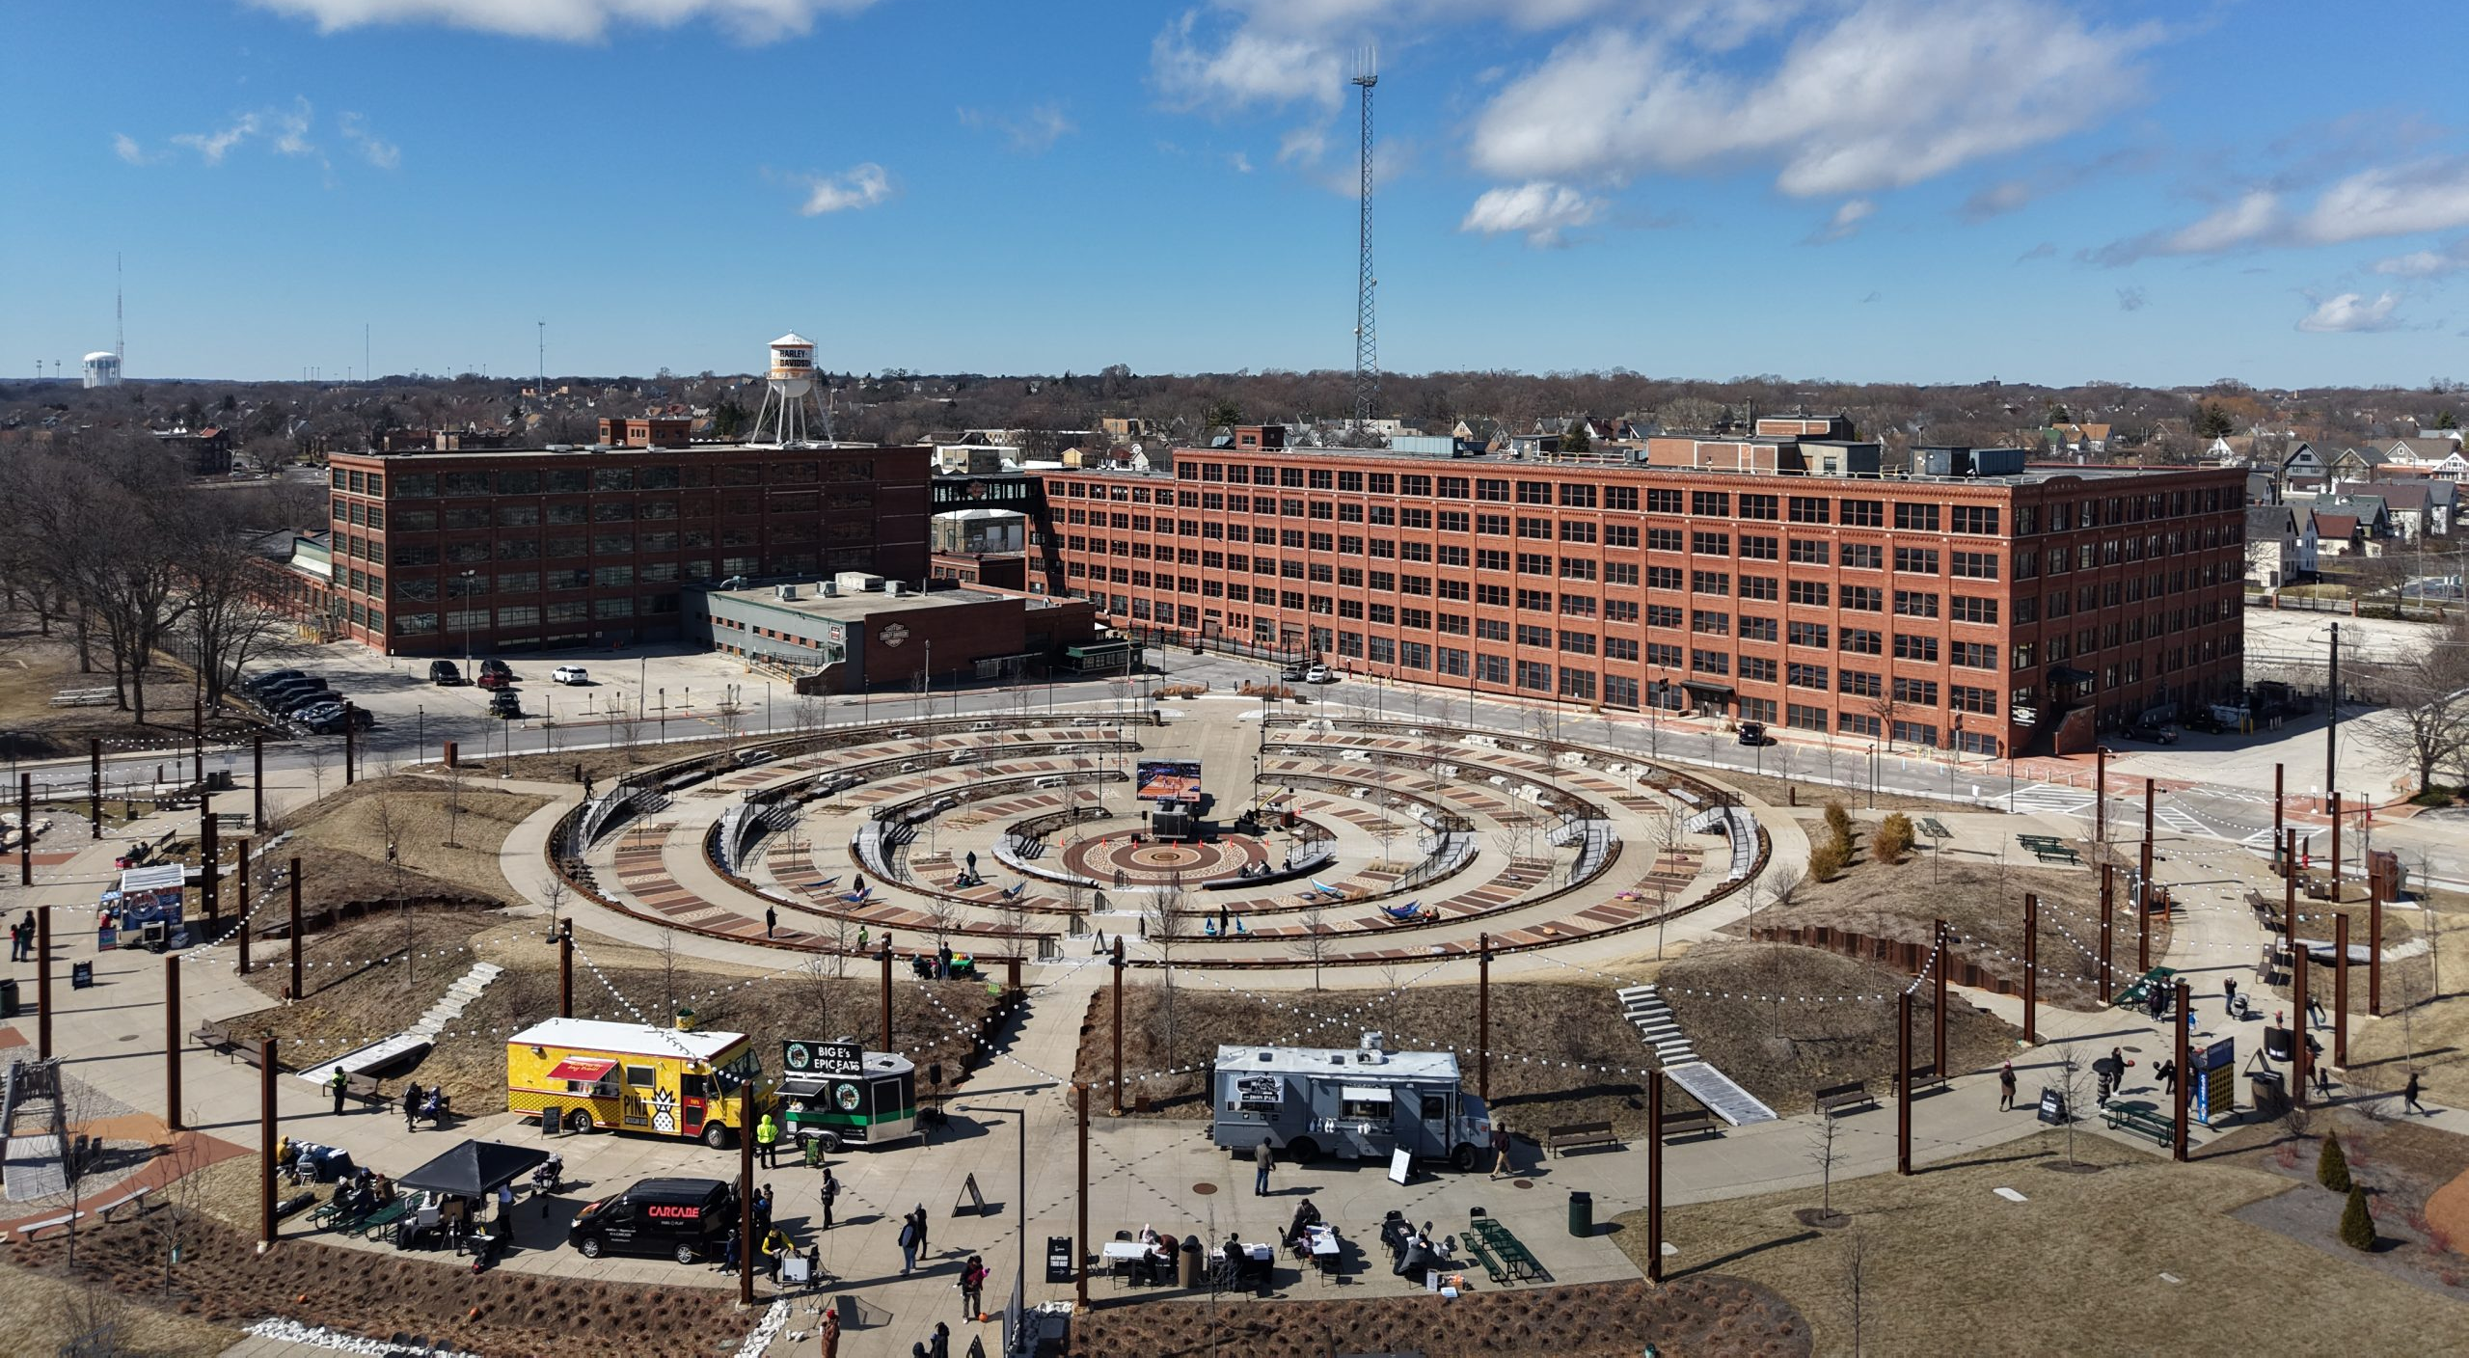
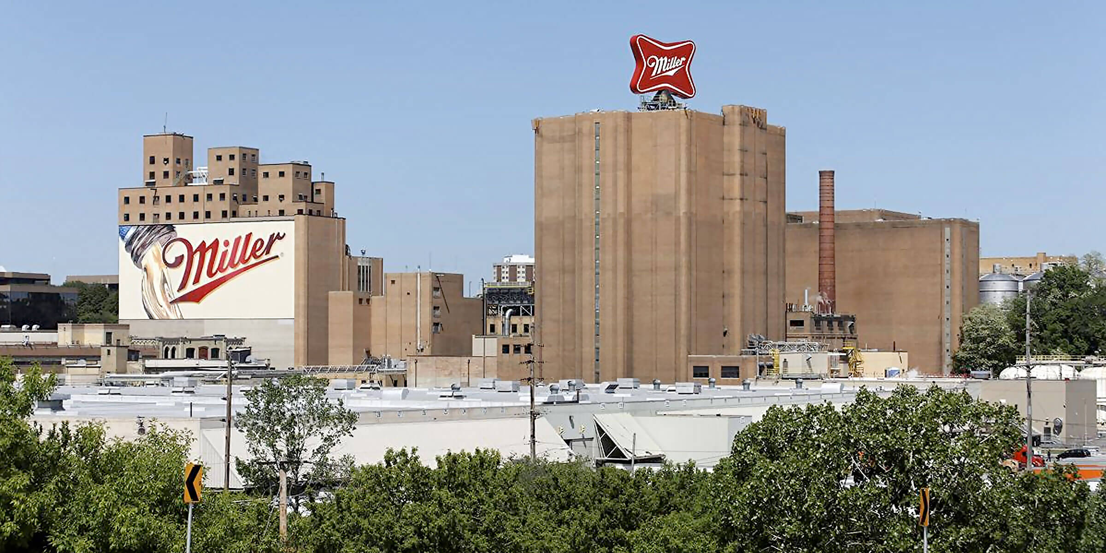
Stakeholder feedback
Individual Stakeholder Meetings
Harley Davidson:
Connect to programming at Davidson Park
Corporate headquarters campus being reactivated
Supportive of the trail
Molson Coors:
Connect to Miller visitor center
Like direct trail access to American Family Field
Avoid heavy truck traffic areas
Some security concerns

Slide 25
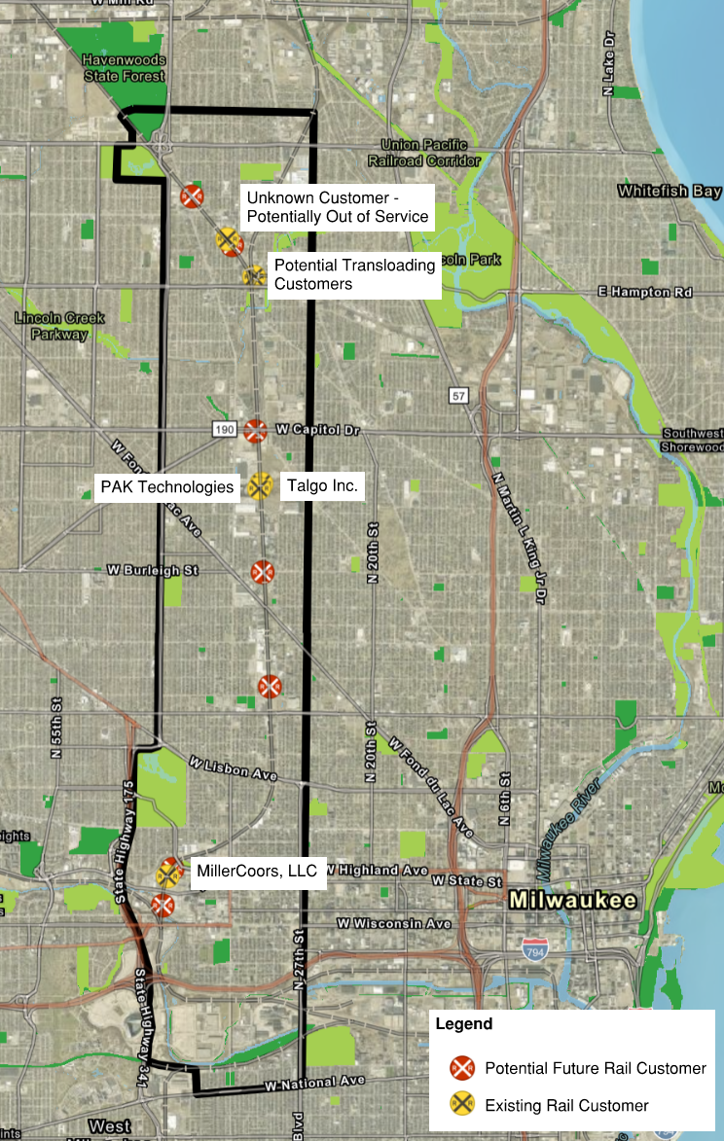
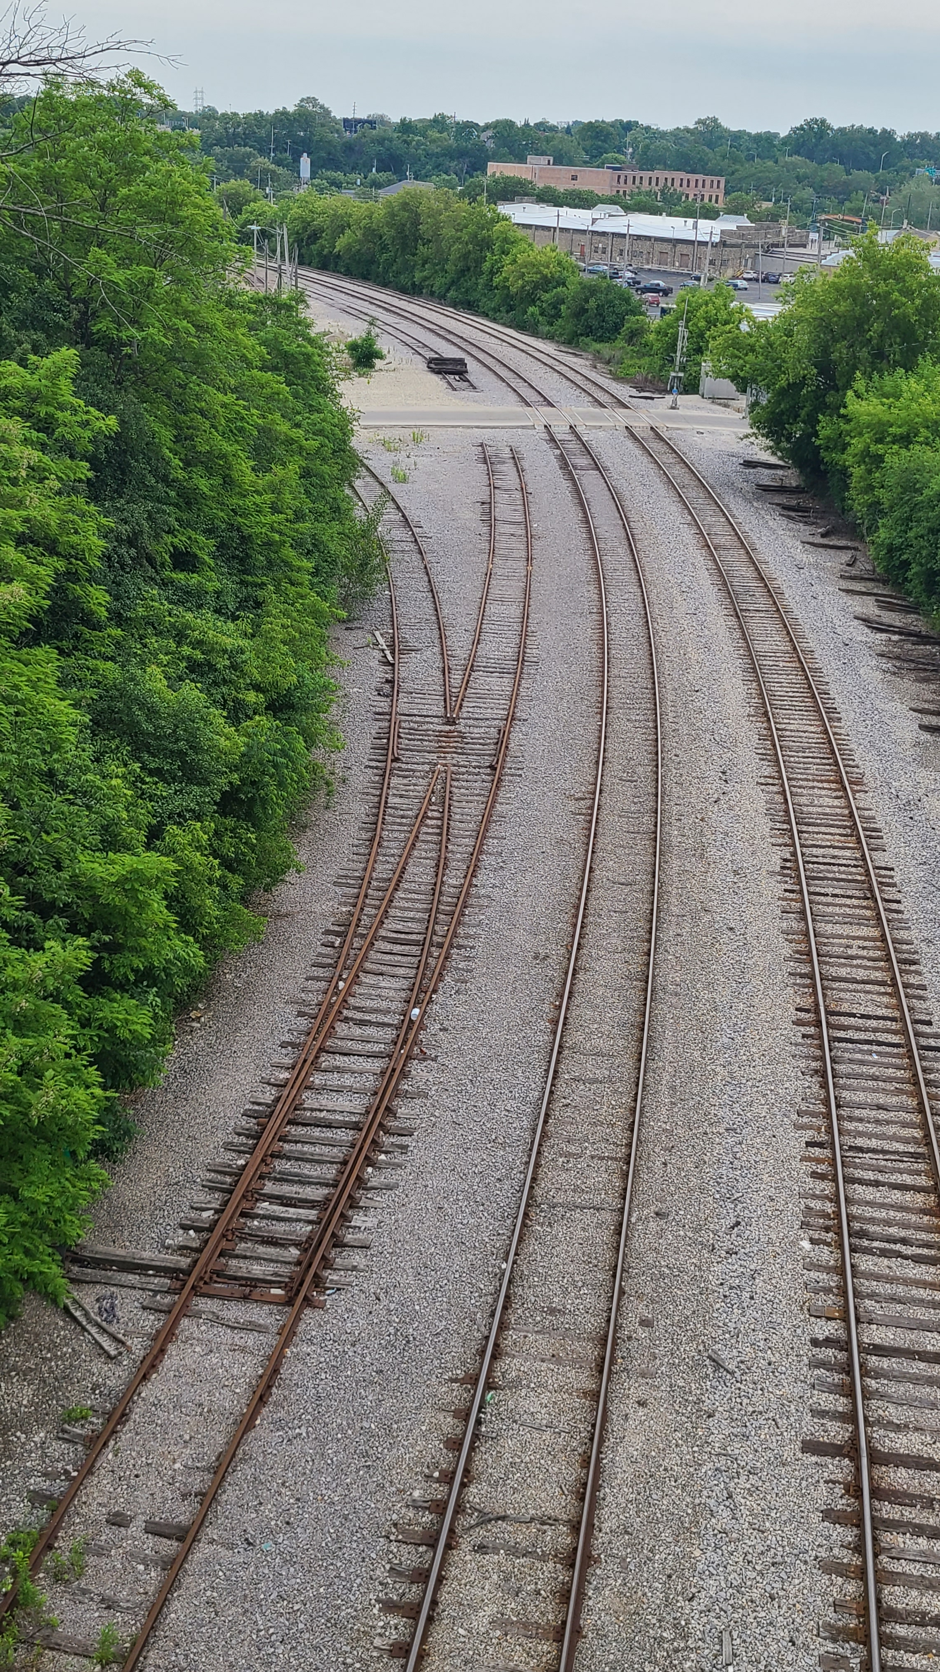
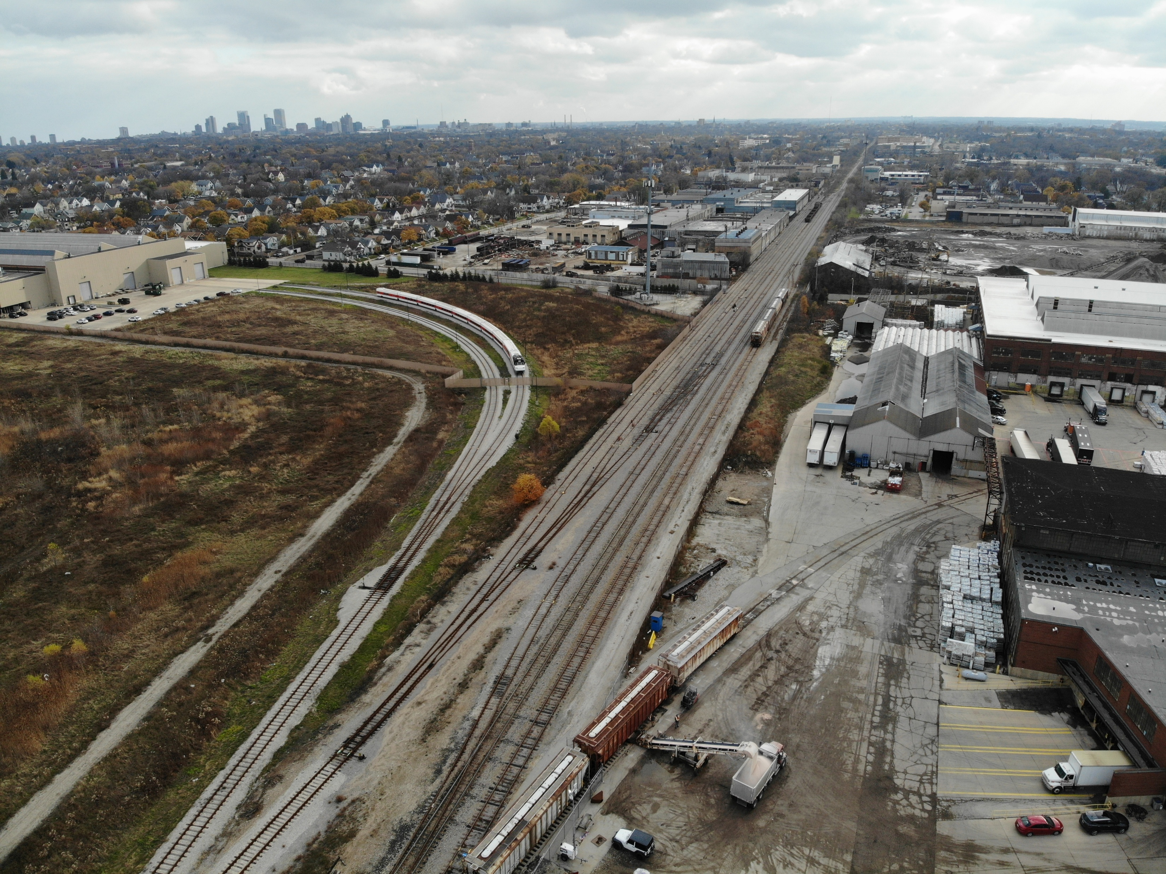
Stakeholder feedback
WATCO/WSOR Meeting
Concerns with liability and public use of corridor
“Not a stakeholder”
A parallel trail in the rail corridor is a non-starter
Open to separated crossings (bridges over or under), not at-grade
Open to short encroachments in right-of-way (<100 ft)

Slide 26
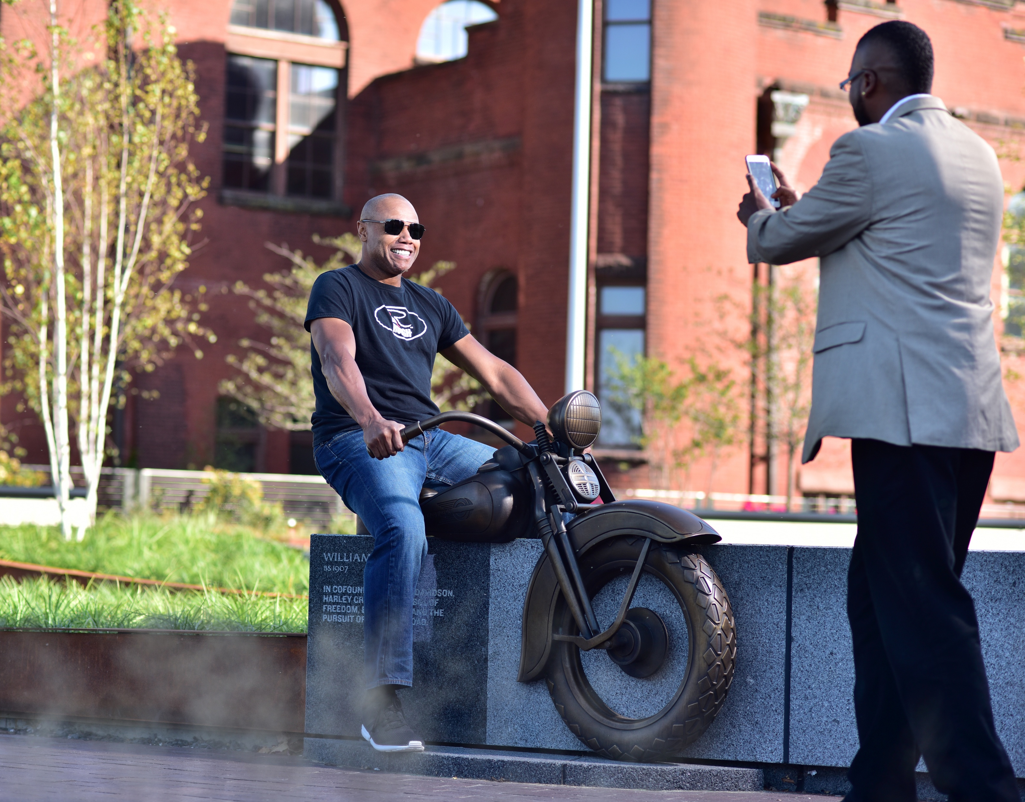
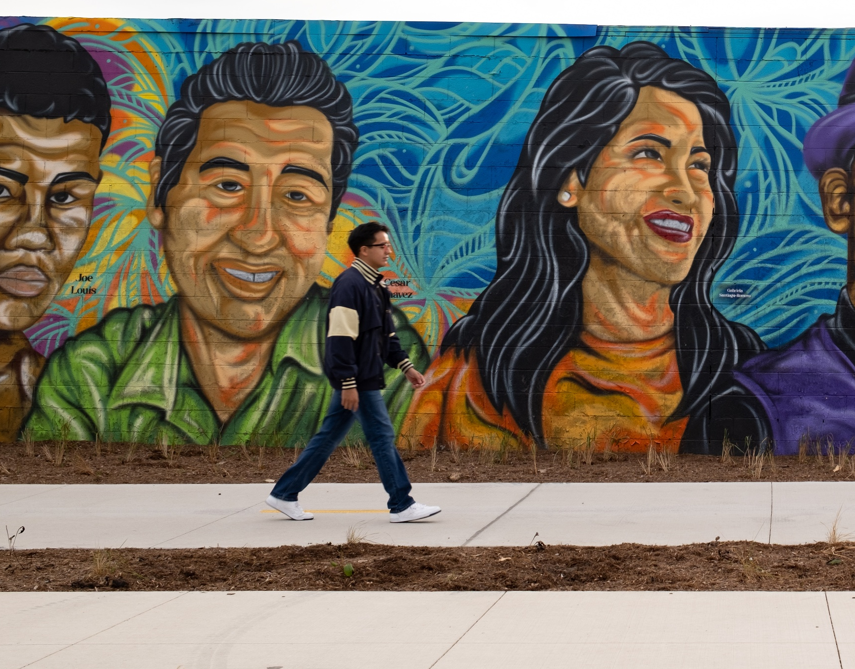
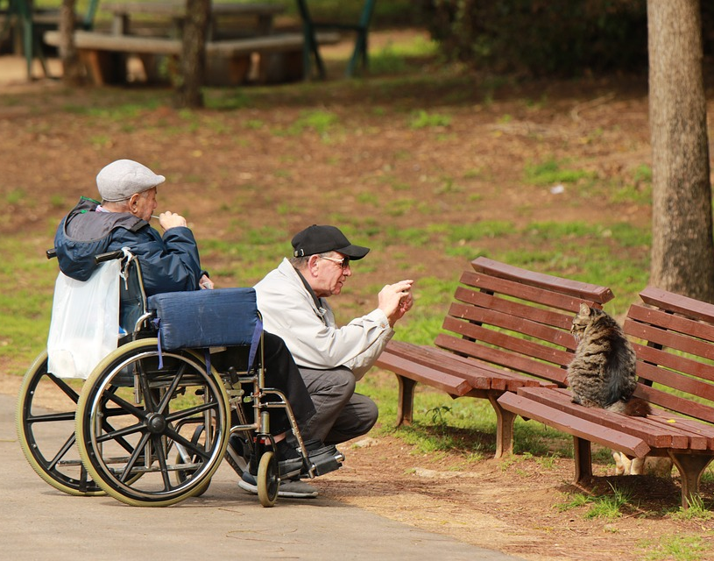
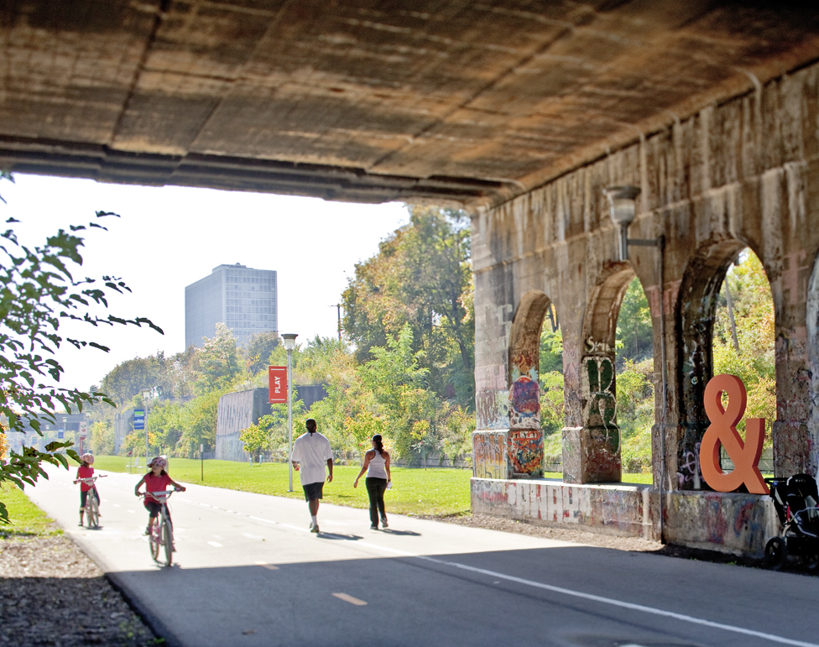
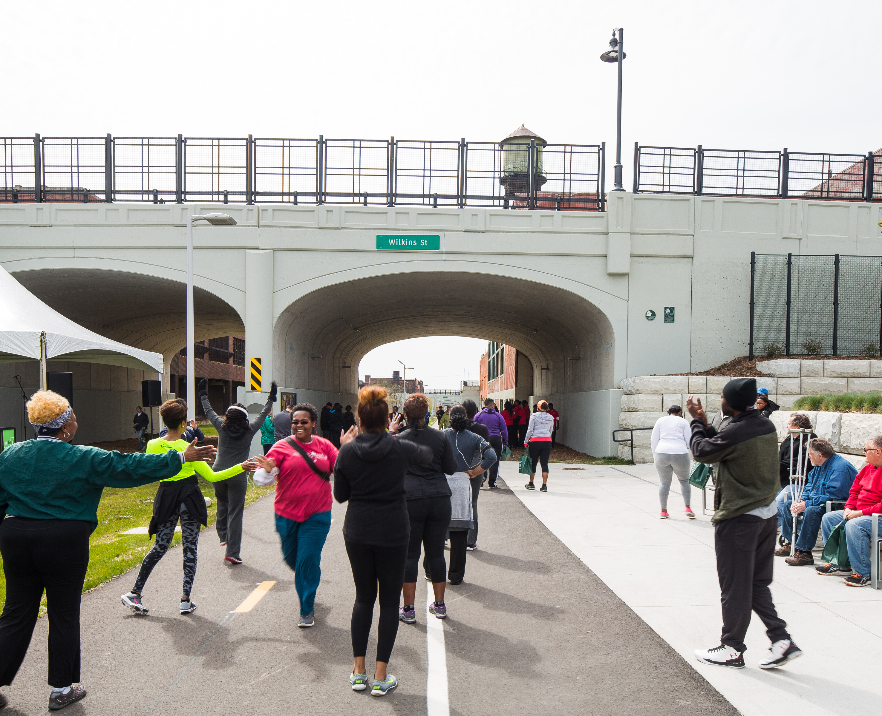
Quality of life
How can a trail serve the community?
The proposed 30th Street Trail will be an authentic community asset which enhances the quality of life in Milwaukee by providing an inclusive and safe corridor that reflects community identity and celebrates local history and industrial heritage.
Authenticity
Culture & Art
Inclusive
Safe Space
Placemaking
Celebration of local history and heritage through story-telling
Enhanced community identity through public art
Accessible for all ages and abilities
A well designed, welcoming corridor which is safe at all times of day
A place for social connections
8%
15%
22%
12%
43%

Slide 27
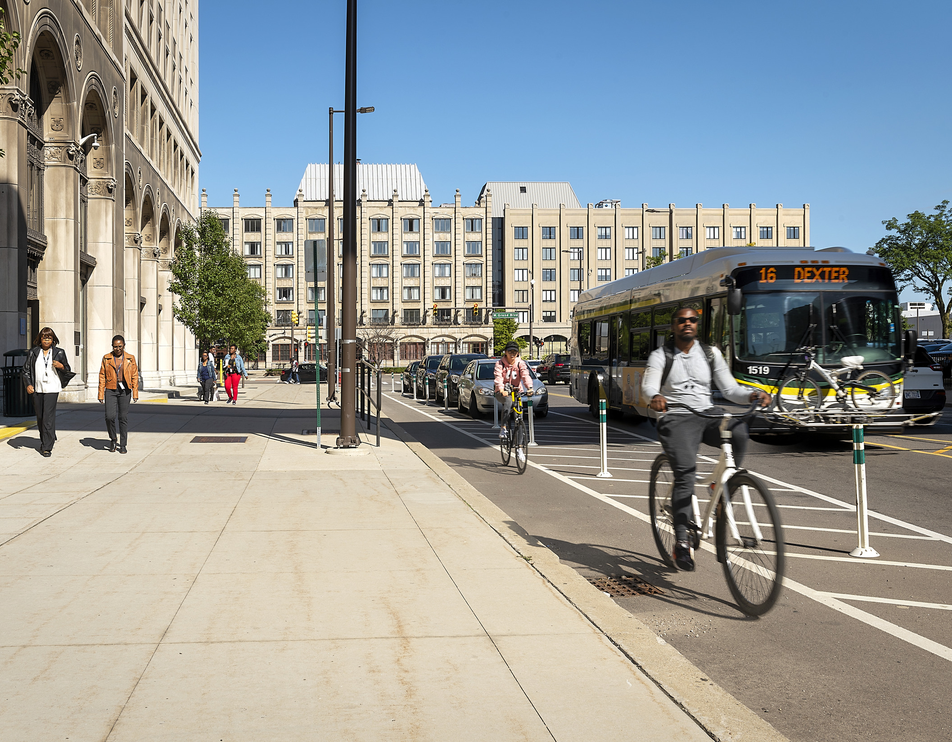
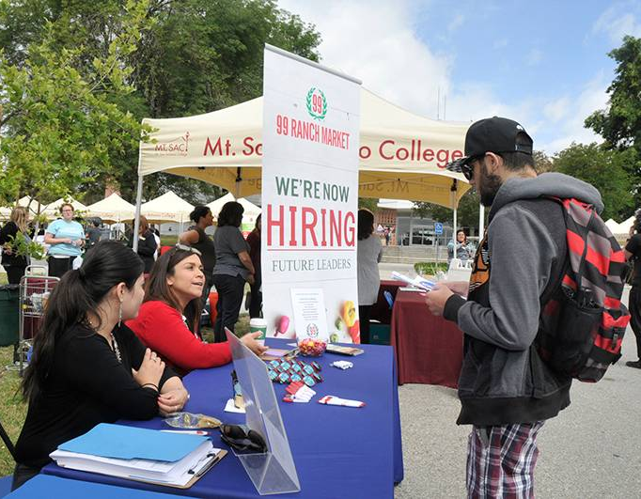
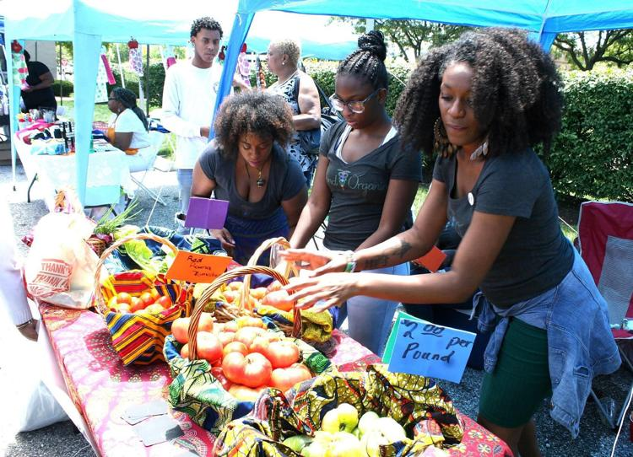
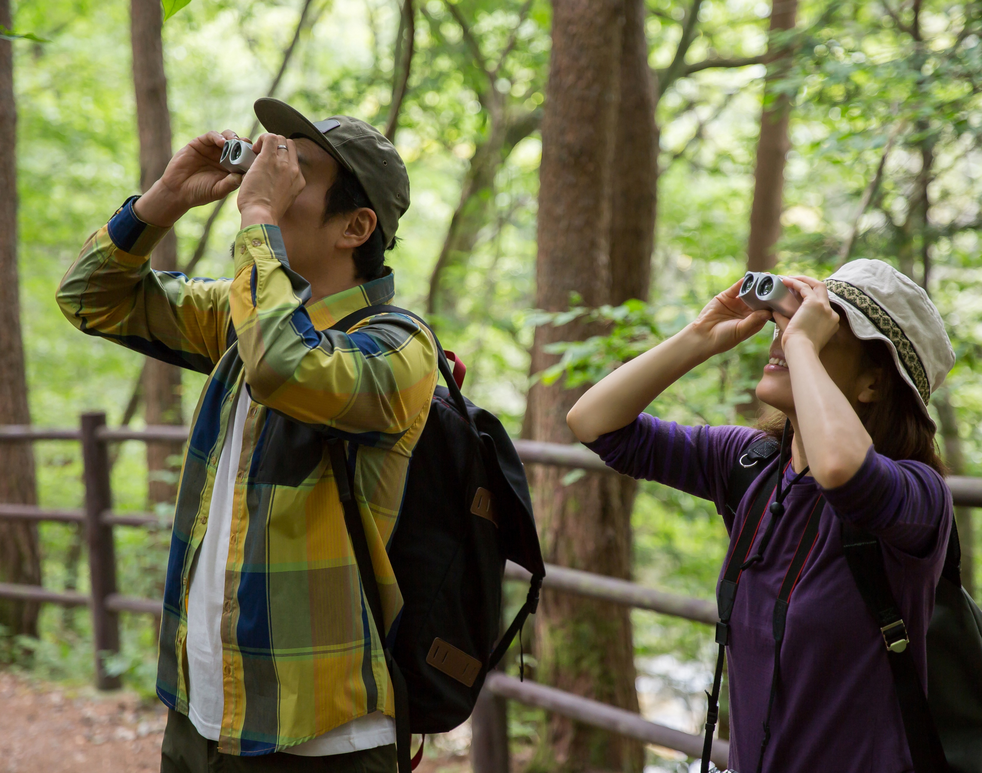
Local economy
How can a trail serve the community?
The proposed 30th Street Trail will improve the local economy by spurring investment along the corridor, creating connections to employment, goods and services, and attractive visitors.
Employment Access
Catalyst
Support Business
Tourism
Safe transportation options to jobs
Spur economic opportunity in the corridor
Access to retail, grocery stores and services
Spur economic activity through attracting more visitors to the region
24%
29%
35%
12%

Slide 28

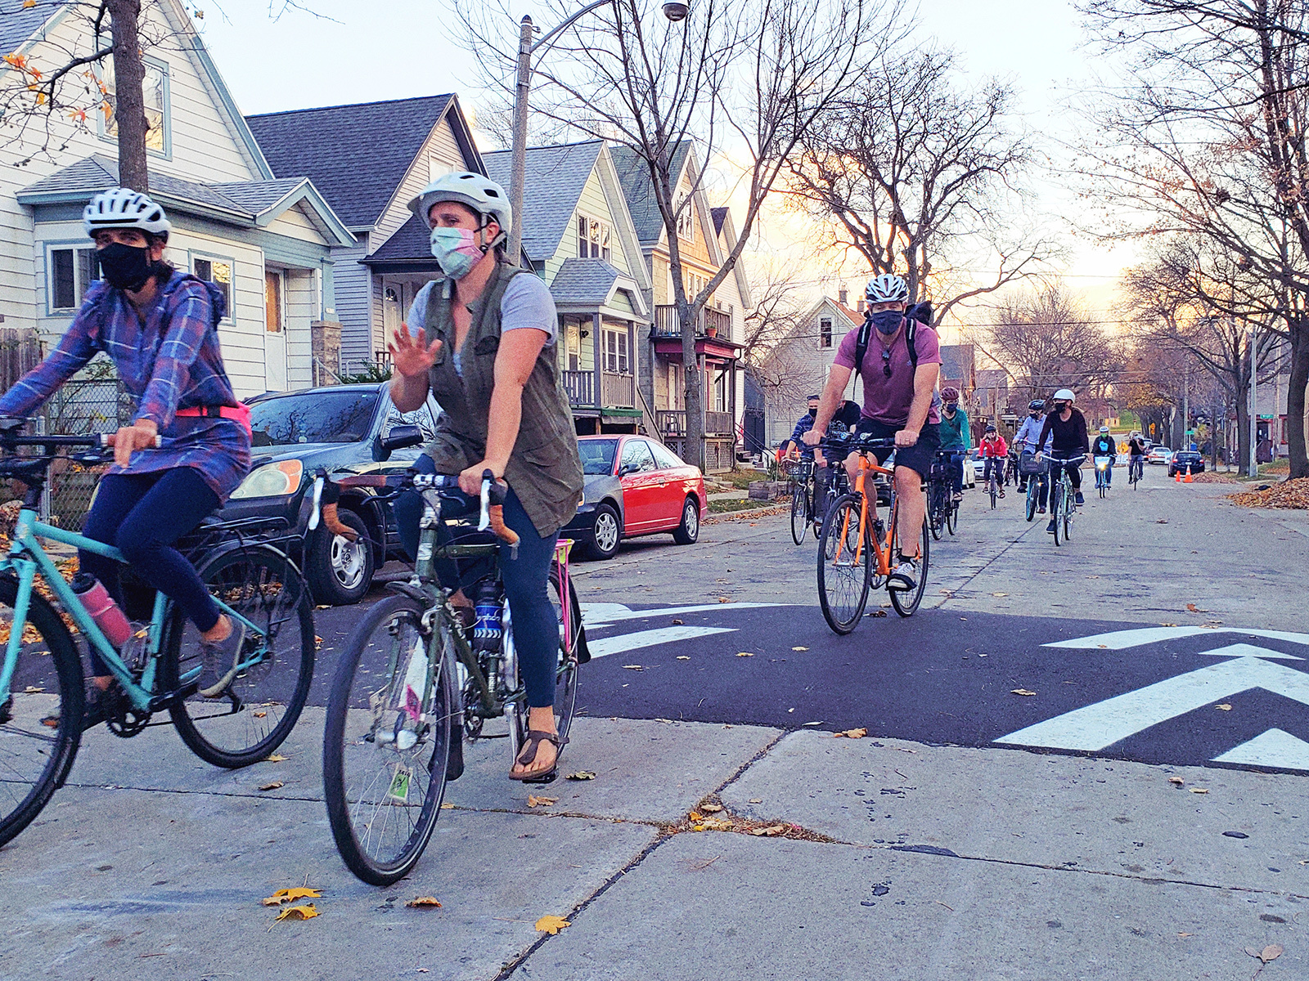
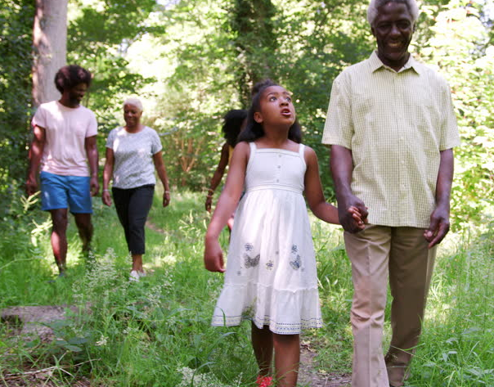
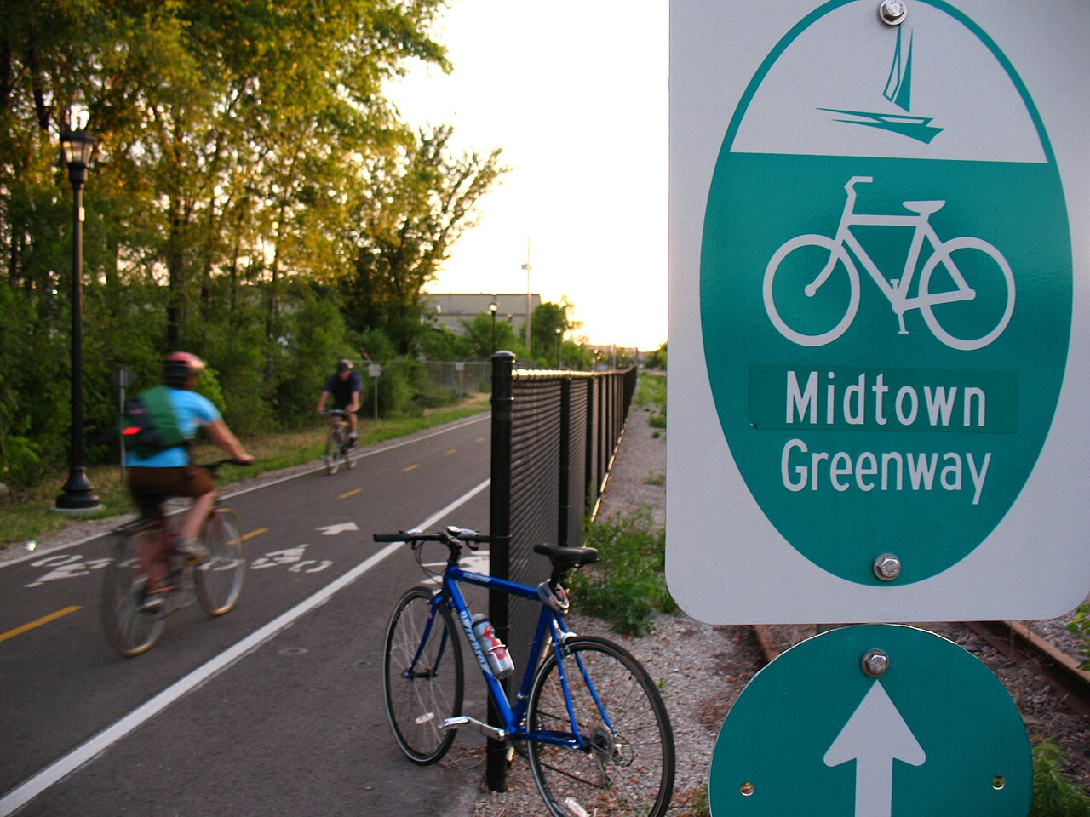
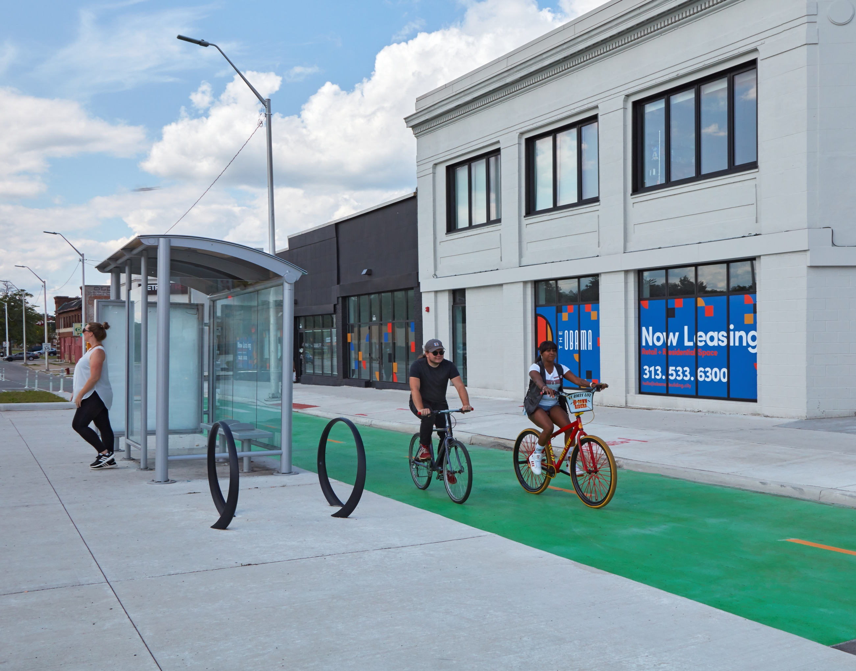
Connectivity & wellness
How can a trail serve the community?
The proposed 30th Street Trail would support the physical and mental wellbeing of community members by offering safe and diverse recreational opportunities, connections to nature and other key destinations as well as healthy transportation choices.
Physical recreation
Neighborhood connections
Access to Nature
Intuitive
Safer Streets
Spaces for physical activities (biking, walking, cross-training)
Easy access to the trail from key destinations and neighborhoods
Opportunities to connect to natural spaces
Clear wayfinding and trailheads for navigating to and from the trail
Traffic calming and protected on-street bike lanes where necessary
30%
25%
17%
5%
23%

Slide 29

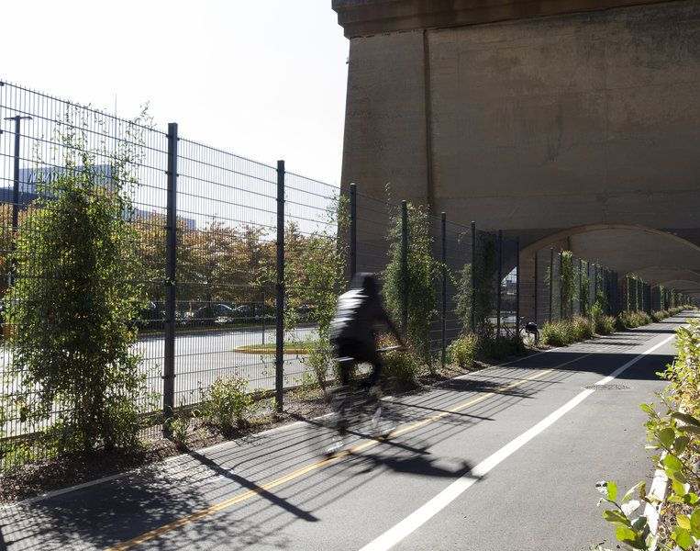
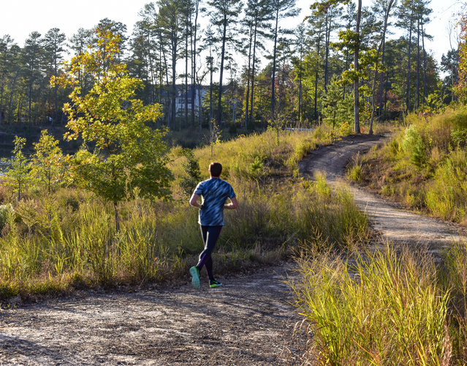
Environment & sustainability
How can a trail serve the community?
The design for the proposed 30th Street Trail will be sustainable, address climate resilience, and contribute to a healthy environment.
Green infrastructure
Ecosystem
Resilient
Climate
Green stormwater practices to mitigate area flooding
Habitat for local urban wildlife (birds, pollinators, etc)
Designed for long-term sustainability and minimal maintenance
Designed to minimize carbon footprint
28%
29%
20%
23%

Slide 30
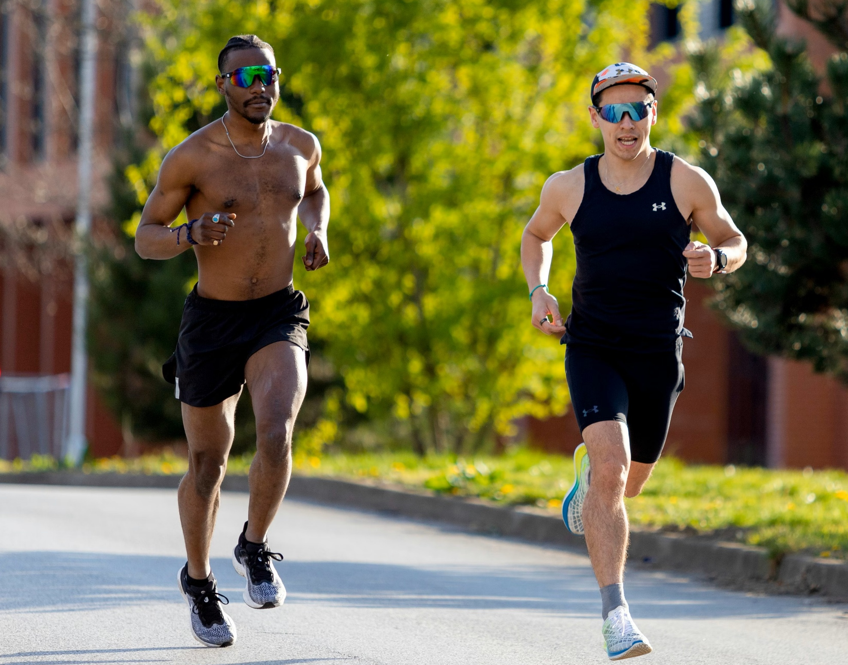
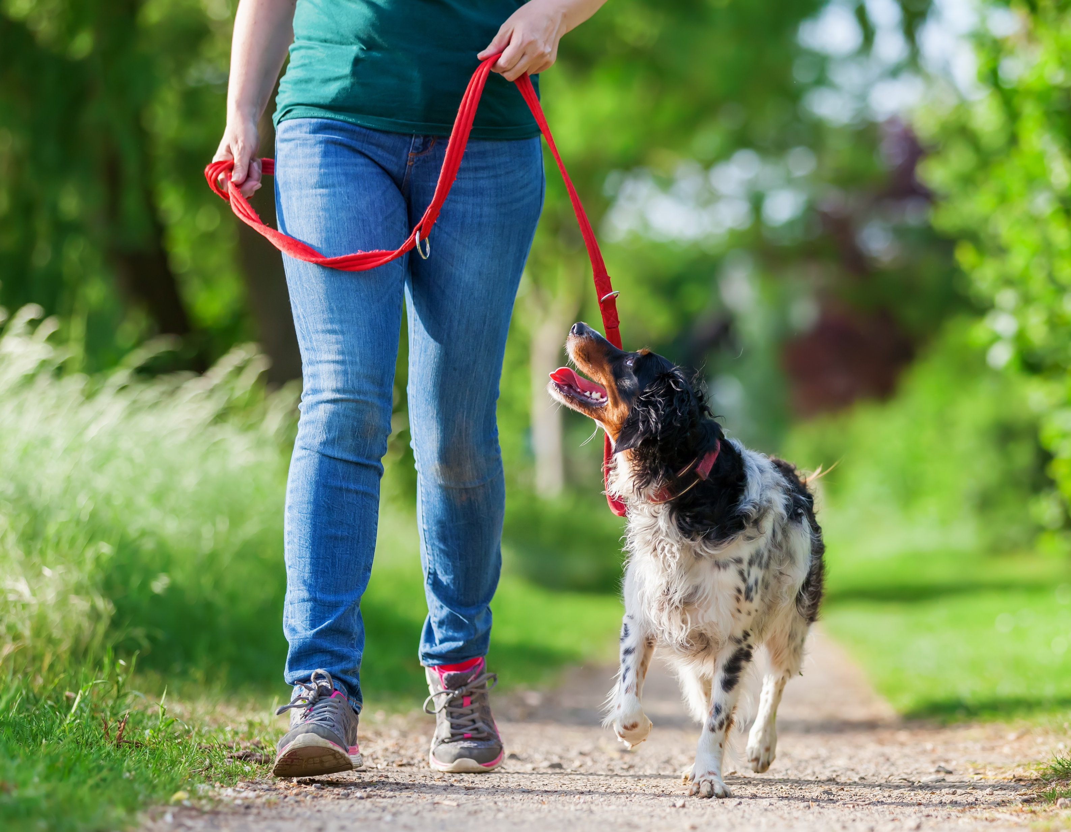
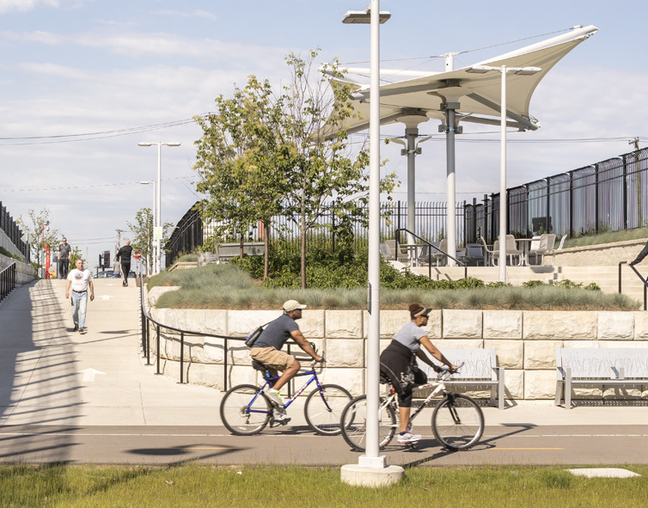
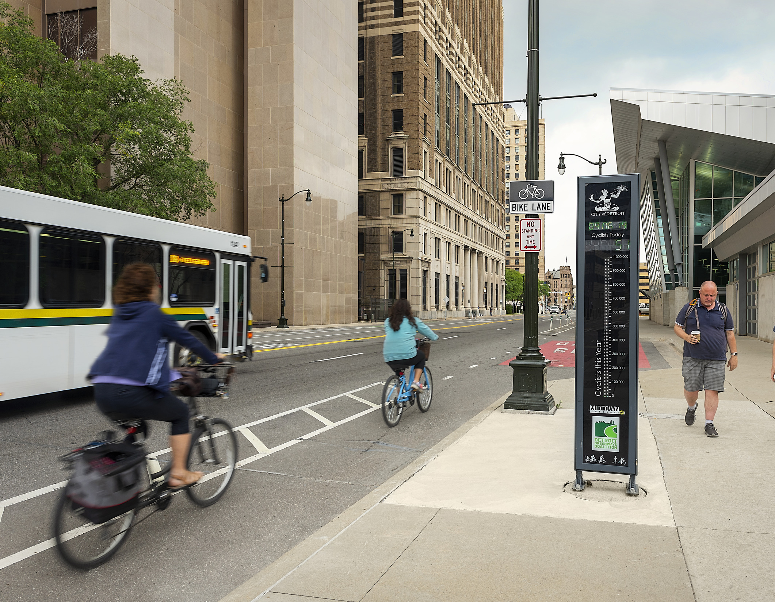
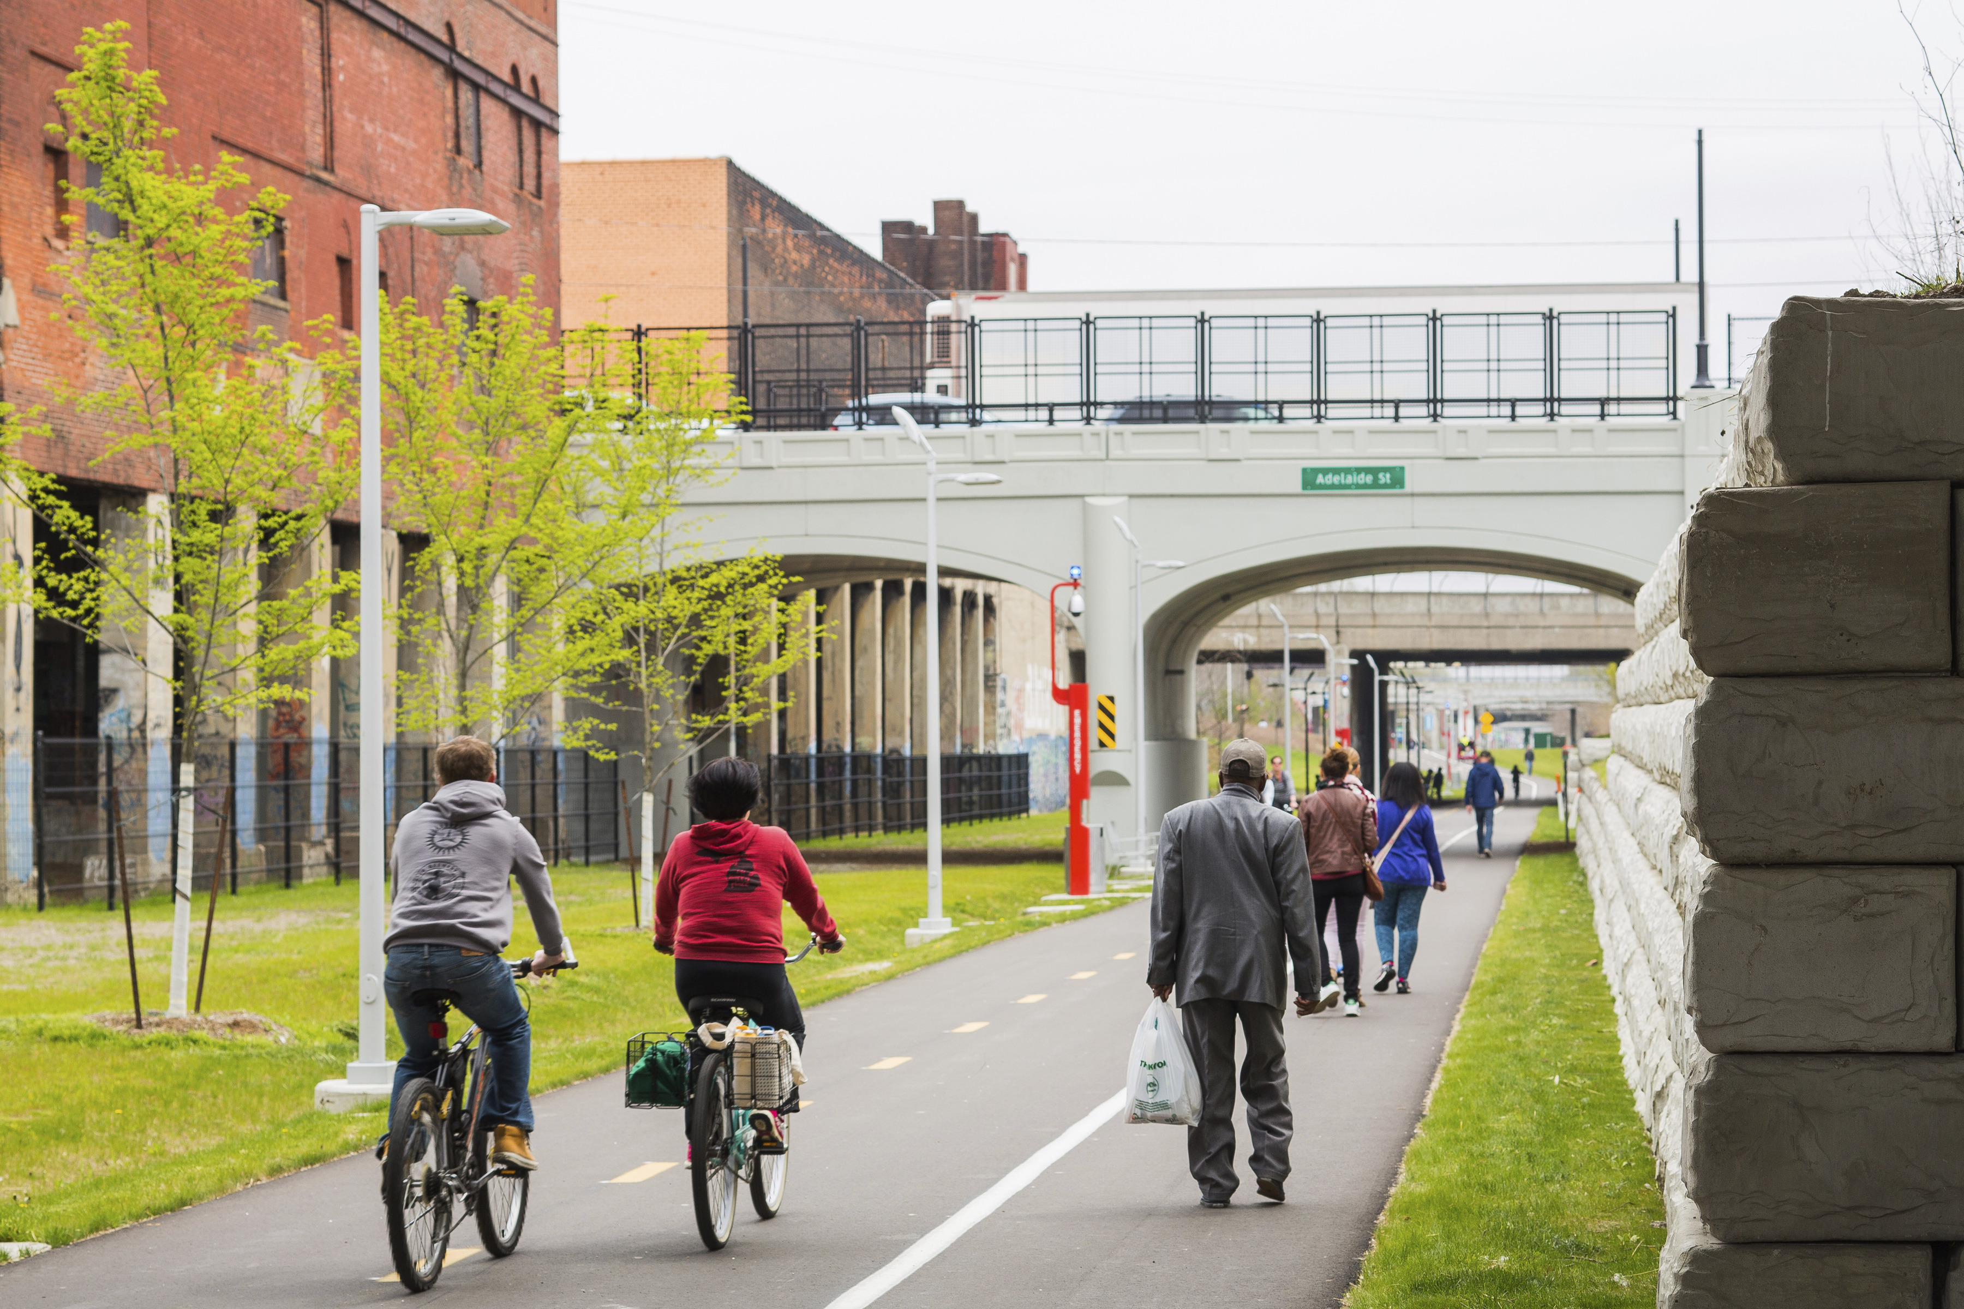
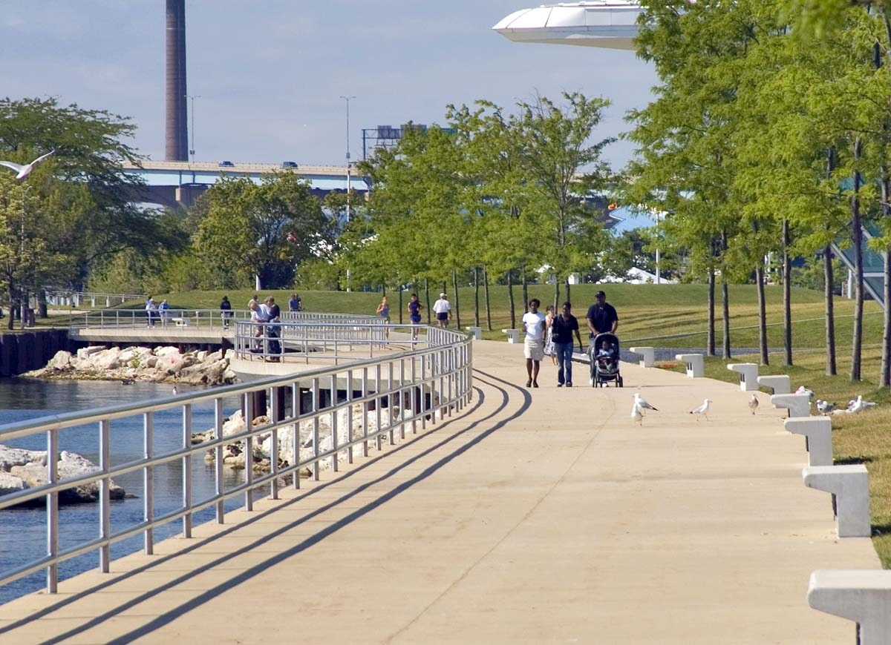
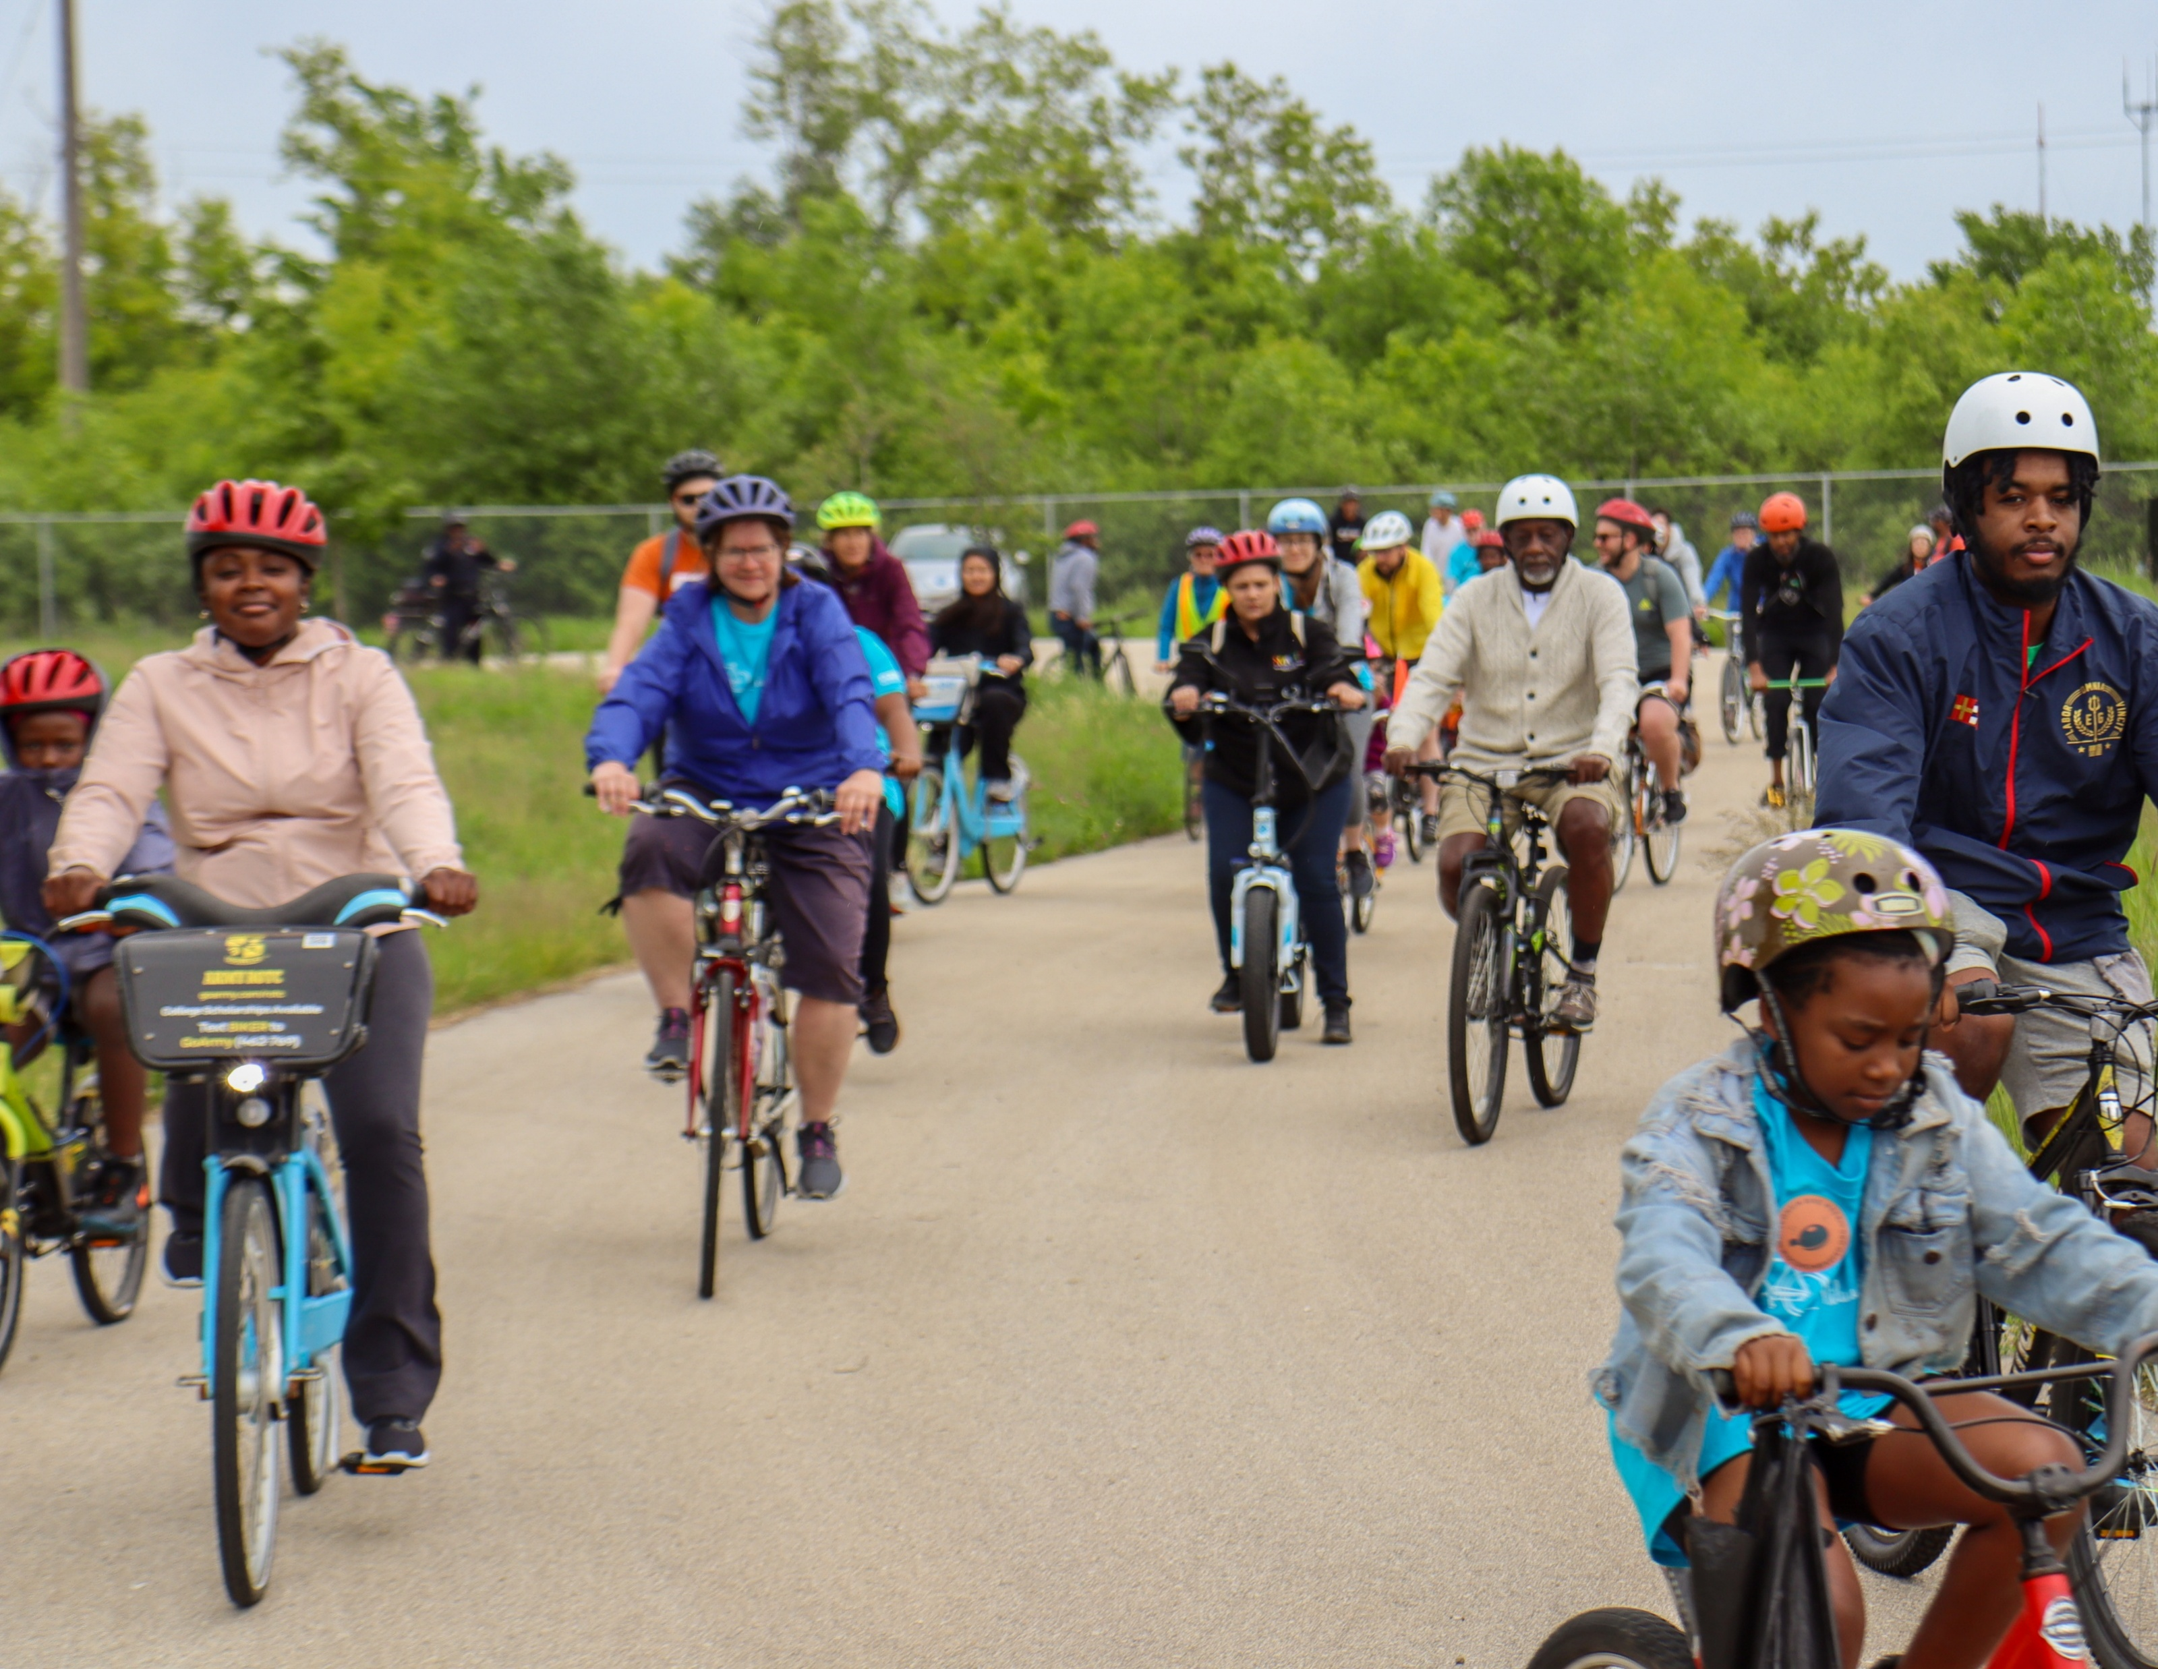

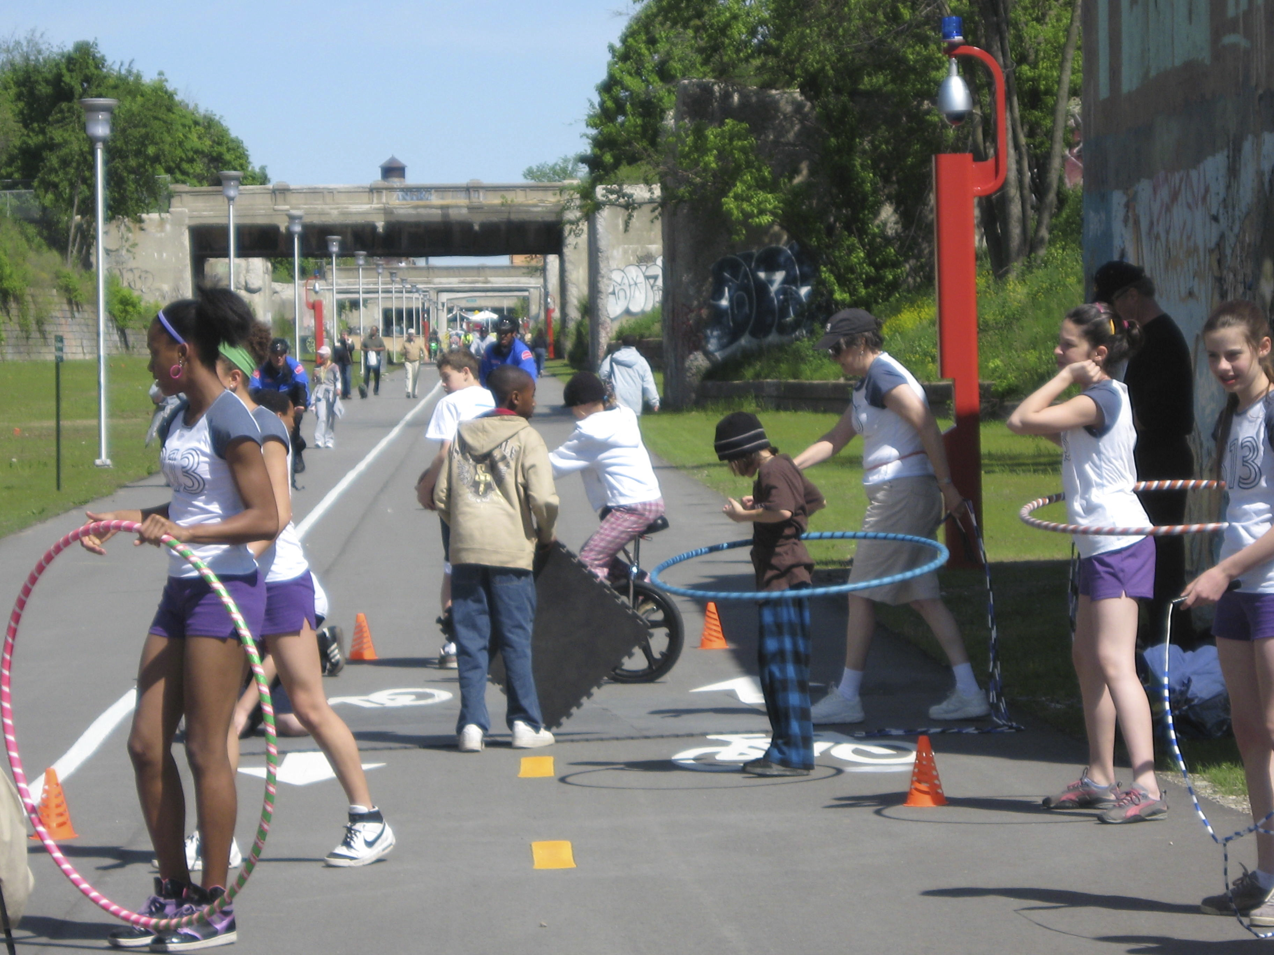
Envisioning a future trail
How would you use the trail?
30%
3%
8%
3%
5%
Recreation and fitness
Walking a pet
Commuting to work or school
Connecting to a bus or rideshare
Shopping or running errands
24%
13%
13%
1%
Connecting to a park, other trails, or the lakefront
Social gatherings (group runs, bike rides, other community events)
Fresh air, meditation, people watching, taking a break
Other

Slide 31
Stakeholder feedback
Public Advisory Committee, TAC, Focus Groups, and EDP Task Force
Prioritize safety above everything
Link neighborhoods & trail network
Showcase local history & culture
Serve, reflect and uplift community
Create jobs & support businesses
Support health, wellness & recreation
Prepare for the future
Partner with schools, youth programs
Keep the rail corridor as a critical asset

Slide 32
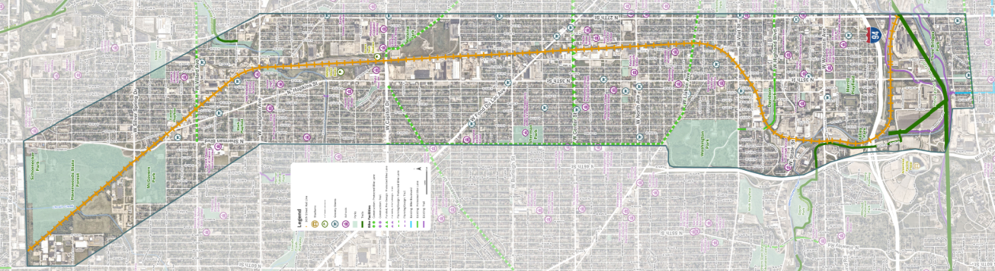
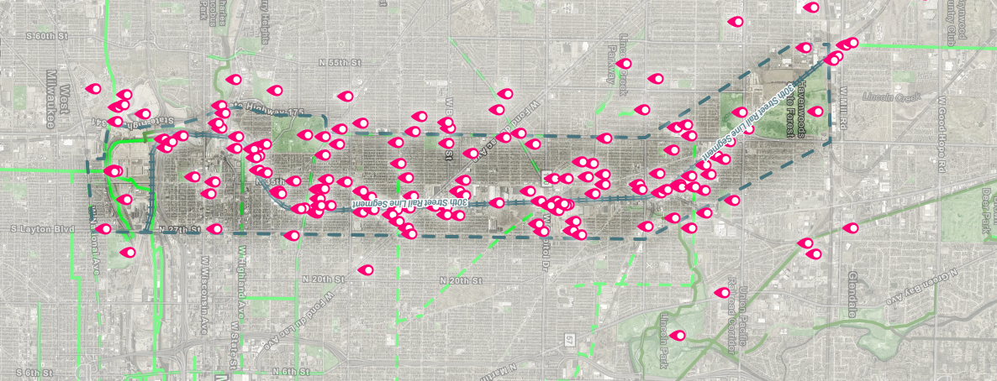
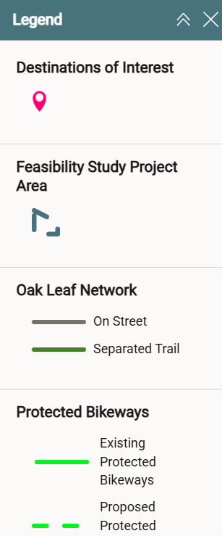
Mapping exercise
Graphically depict where the most dots were added
Interactive map (online)
Sticky dots on a large map (PIM)
Where would the trail take you?
American Family Field
McGovern Park
Havenwoods State Forest
Washington Park
10
10
17
12
5
LEGEND
4
4
4
4
Three Bridges Park
City of Milwaukee Library
MMSD West Basin

Slide 33
Summary of Key destinations

Slide 34
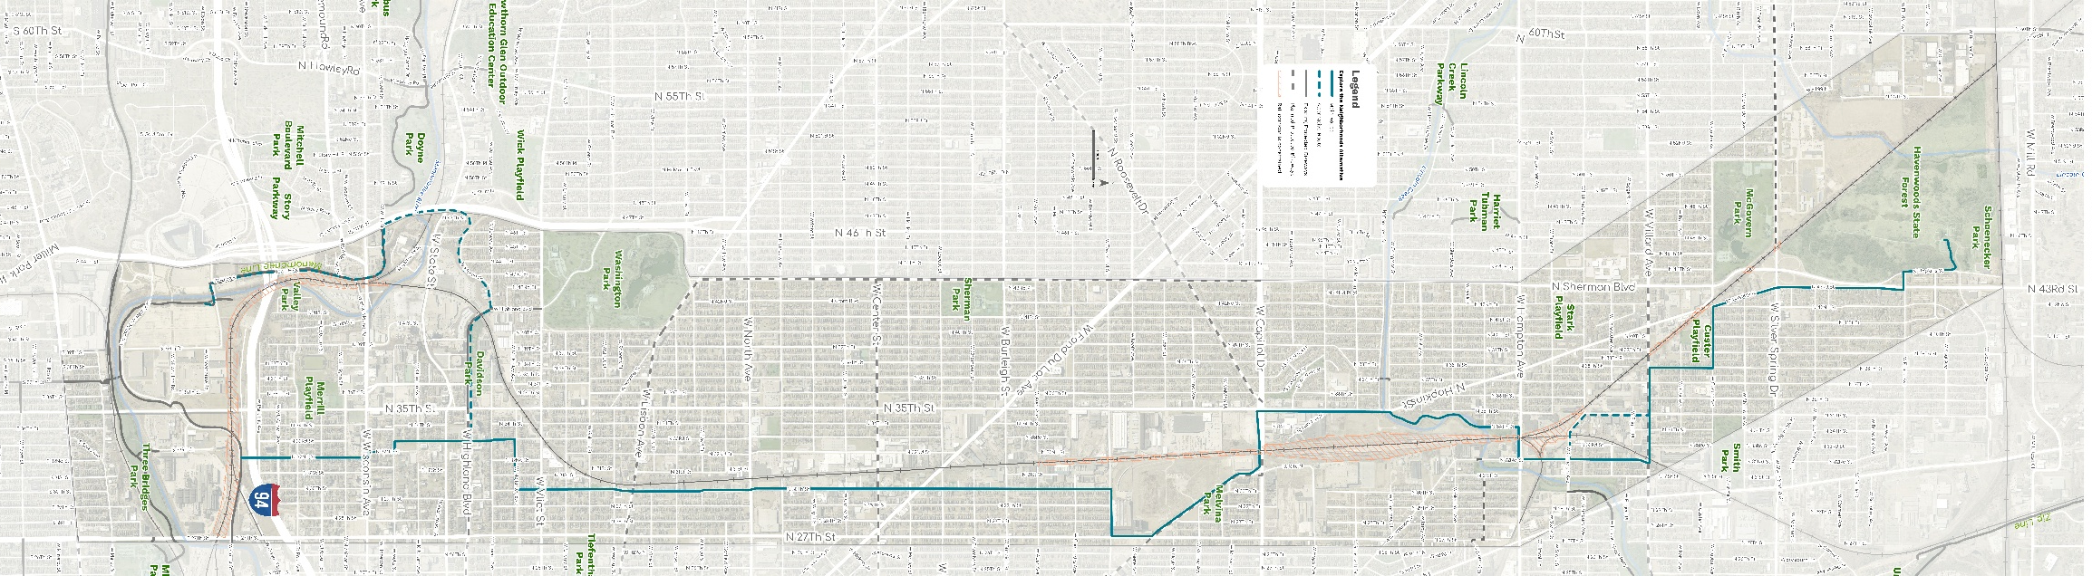
alternatives overview
Corridor Direct
Greenway Link
Explore the Neighborhoods

Slide 35
Alternatives ranking criteria
Average of SmithGroup team rankings
 |  |  |  | Alternatives
 |  | Criteria Weight |  | Corridor Direct | Greenway Link | Explore the Neighborhoods | Criteria Metrics/Description
Safety & Experience |  |  |  | 85 | 70 | 53
 | Minimized Traffic Conflicts | 4 |  | 8.0 | 4.3 | 1.3 | Fewest number of intersections or at-grade crossings (1 = most conflicts, 10 = fewest)
 | Safe and Welcoming | 4 |  | 5.7 | 5.0 | 3.3 | Ability for someone to feel safe on the trail (visibility, evacuation routes, etc)
 | Safer Streets Investment | 3 |  | 2.7 | 5.0 | 8.7 | Most miles of on-street traffic calming improvements
 | Trail Experience & Comfort | 3 |  | 7.3 | 6.0 | 2.7 | % of the corridor that is pleasing to ride on (feels like a trail, limited grade changes, generous widths)
Feasibility |  |  |  | 21 | 31 | 50
 | Structures / Cost / Constructability | 4 |  | 2.7 | 3.3 | 5.0 | Number and relative cost of structures needed (1 = high cost, 10 = lower costs)
 | Real Estate / Easements | 2 |  | 2.3 | 5.0 | 6.0 | % of project that does not require outside permission/approvals/easements
 | Rail Infrastructure Impacts | 1 |  | 1.7 | 5.3 | 9.3 | Number of impacts to existing rail infrastructure or ROW (1 = higher impact, 10 = lowest)
 | Environmental & Regulatory | 1 |  | 3.7 | 2.3 | 8.3 | # of places where regulatory approval is needed & level of complexity (river corridors, etc)
Connectivity |  |  |  | 72 | 81 | 75
 | Travel Time & Continuity | 4 |  | 8.3 | 5.0 | 2.7 | Directness of route through corridor, north to south, number of places to stop
 | Connections to Community Assets | 4 |  | 4.7 | 7.7 | 7.7 | Number of connections to community assets/destinations
 | Accessibility & Visibility | 3 |  | 4.0 | 5.7 | 6.0 | Number of ways to connect to the trail, ability to wayfind to the trail, visibility of trail from neighborhoods
 | Connections to Other Modes | 2 |  | 4.0 | 6.7 | 7.7 | Ability to connect to transit, other trails, and parking/trailheads
Corridor Activation |  |  |  | 65 | 72 | 53
 | Space for Programming & Amenities | 4 |  | 5.0 | 8.0 | 6.0 | Ability to create space near or adjacent to the trail for programming
 | Ability to Spur Development | 3 |  | 8.0 | 6.7 | 4.3 | How well the trail is likely to attract new development investments
 | New Green Infrastructure or Habitat | 2 |  | 6.7 | 7.3 | 4.7 | Ability to create space near or adjacent to the trail for GI or habitat
 | Activation of Underutilized Properties | 1 |  | 7.7 | 5.3 | 7.0 | Number of underutilized parcels touched by or near the trail that could change
 | Weighted Score |  |  | 242 | 254 | 230
Ratings:
10 - Excellent
9
8 - Above average
7
6
5 - Good
4
3 - Below average
2
1 - Poor
Criteria Weight:
4 = Most important
3 = Important
2 = Somewhat important
1 = Not as important

Slide 36
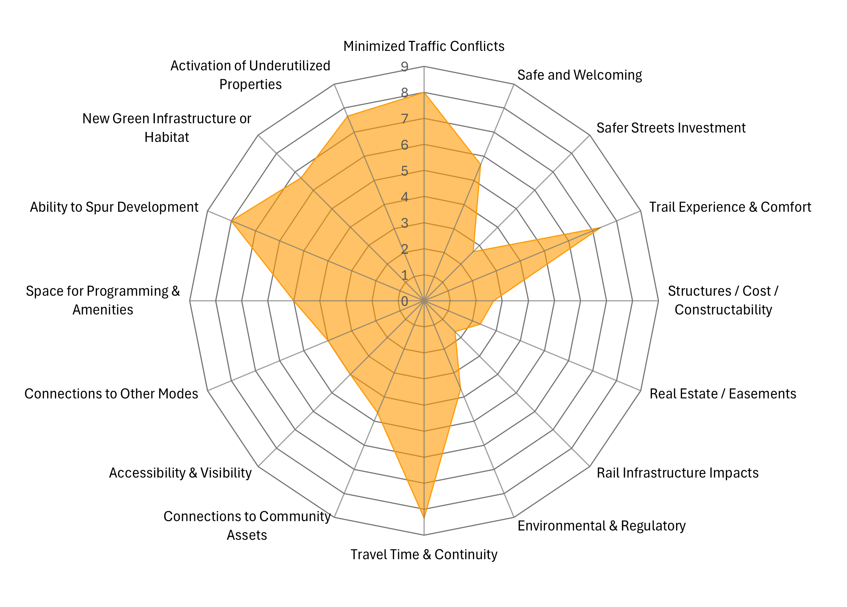
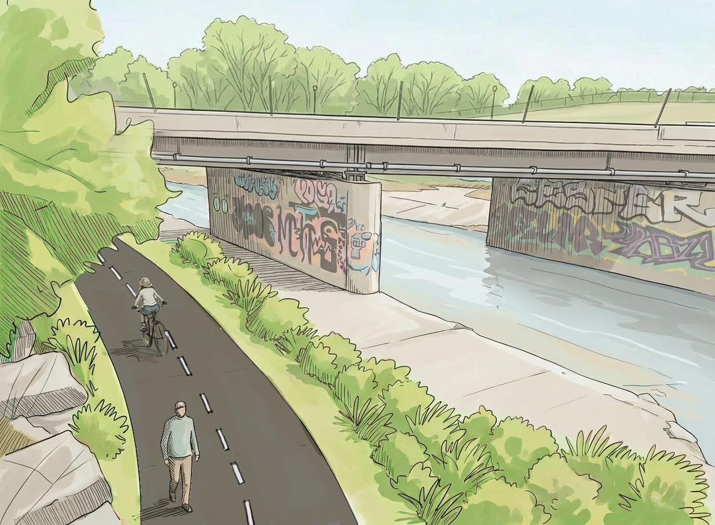
Corridor direct
Alternatives Criteria Ranking Overall Score: 242
Corridor Activation
Safety & Experience
Connectivity
Feasibility

Slide 37
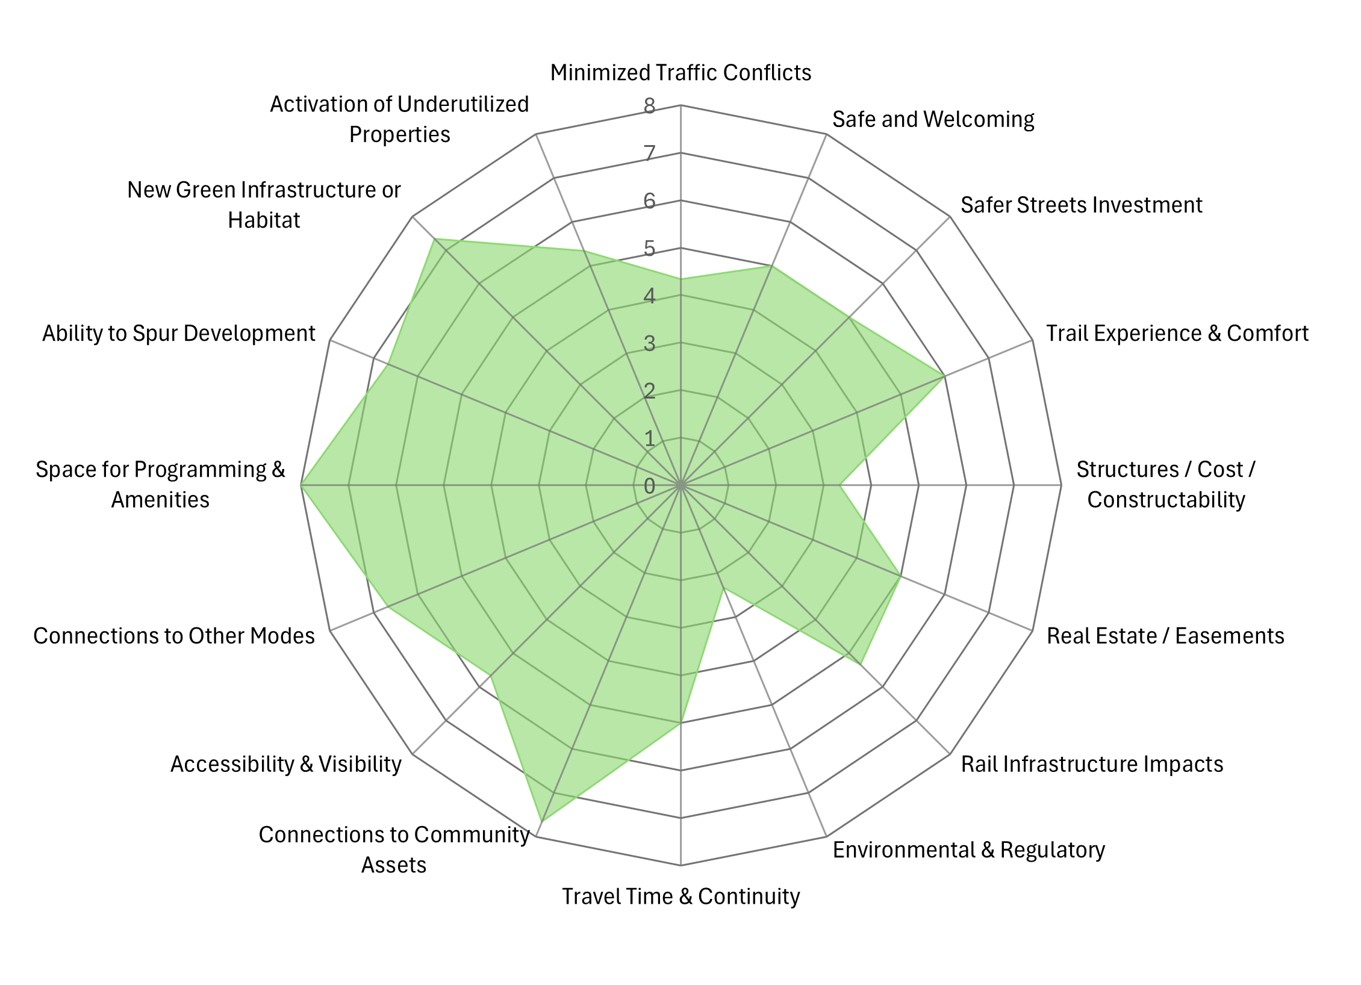
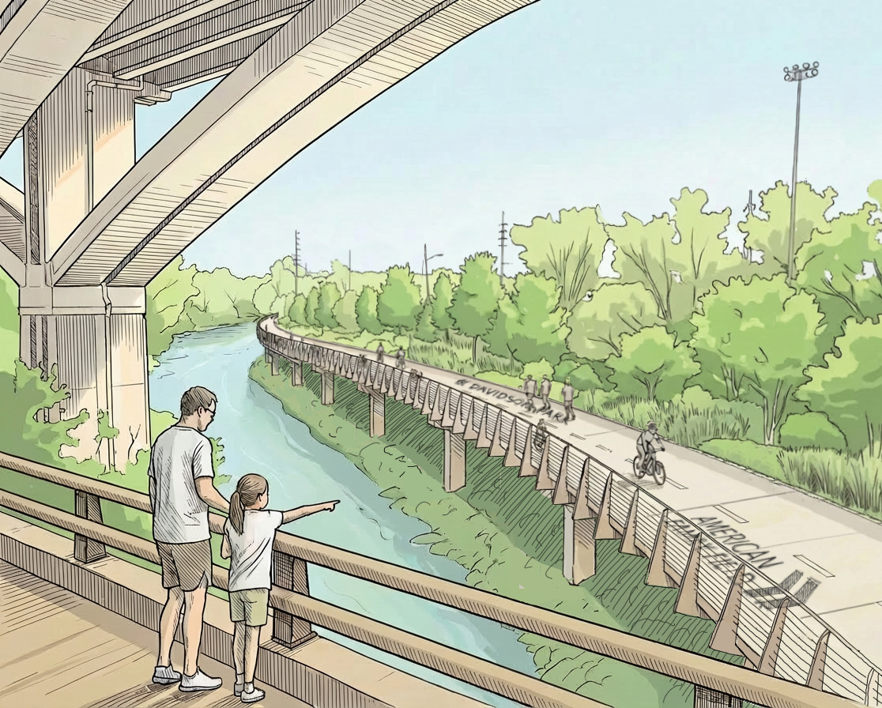
Greenway link
Alternatives Criteria Ranking Overall Score: 254
Corridor Activation
Safety & Experience
Connectivity
Feasibility

Slide 38
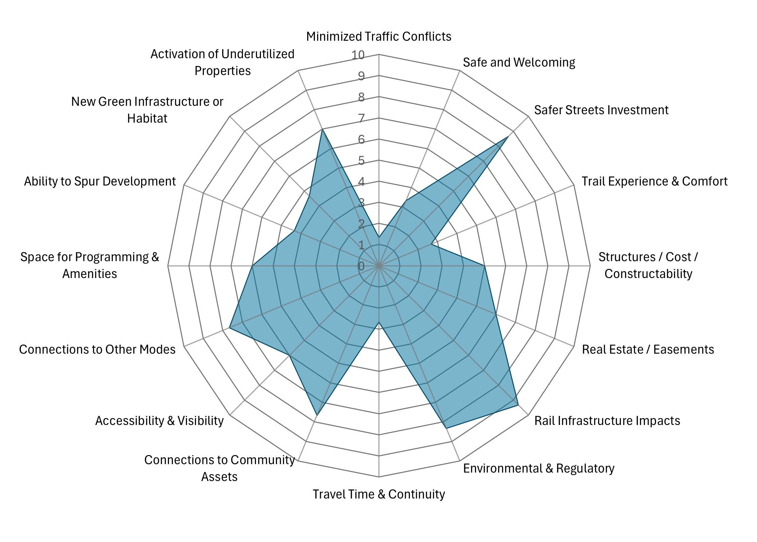
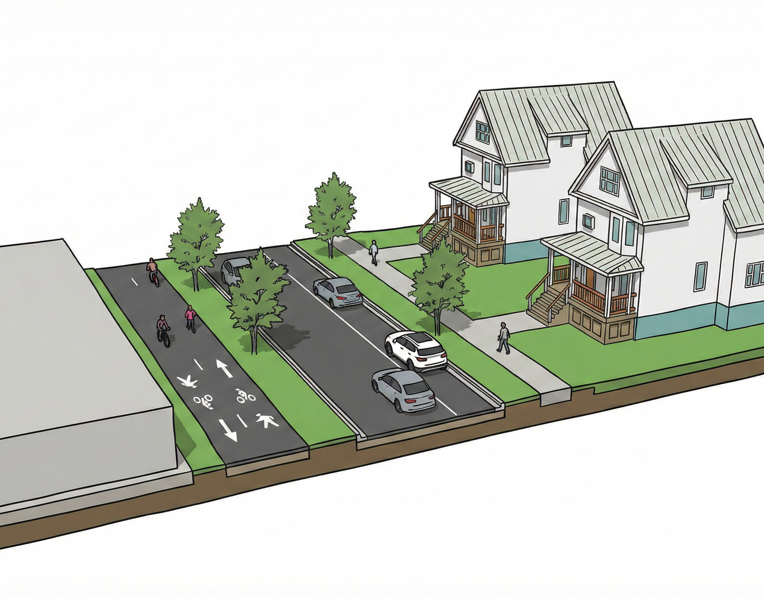
Explore the neighborhoods
Alternatives Criteria Ranking Overall Score: 230
Corridor Activation
Safety & Experience
Connectivity
Feasibility

