Slide 1
Client Rights Forum
Welcome!
May 13, 2026
9am to 10:30am

Slide 2
Agenda
Today’s topics come directly from your survey responses!
Complaint vs Grievances
Multiple grievance clients
Investigations
Reporting Grievances
Brochures & Posters
Q & A
Survey

Slide 3
Complaint vs Grievance
Questions:
How do we determine if it’s a complaint or a grievance? Does it just have to relate to a client’s rights or do they have to say the word grievance? How do we figure out that part of it?
Notes:
Complaints vs Grievances. How do we determine if it’s a complaint or a grievance? Does it just have to relate to a client’s rights or do they have to say the word grievance? How do we figure out that part of it?

Slide 4
Complaint Defined
“Concern” means a complaint, disagreement or dispute which a client or a person on behalf of a client may have with a program or program staff which the client chooses to resolve through the informal resolution process pursuant to s. DHS 94.40 (4).
Notes:
Per DHS 94, a concern is a complaint, disagreement or dispute with a program or program staff that the client would like revolved through informal means. They just want their problem solved. We will get significantly more complaints then actual grievances.
A few things to remember – a complaint can be issued by someone on behalf of the client but it is ultimately up to the client if they choose to proceed with that complaint. And a grievance can move to an informal resolution (or complaint status if that terminology make more sense to you) at any time.

Slide 5
Grievance Defined
“Grievance” means a statement by a grievant that an action or an inaction by a program or its staff has abridged rights guaranteed to the client under s. 51.61, Stats., and this chapter combined with a request that the matter be dealt with through the program’s formal grievance resolution process pursuant to s. DHS 94.40 (5).
Notes:
Per DHS 94, a grievance is when a client states 1) an action or inaction by a program violated their rights and 2) they want the resolve the issue by going through the formal grievance process.
I suggest you discuss the informal resolution and grievance procedure to your client during that initial call so they know their options and can choose. Remind them the goal is to make sure they are receiving the services they need and that their rights being honored.
A grievance can move to an informal resolution at any time, if the client chooses, and a complaint can become a grievance if the 1) client’s rights were violated and 2) they want to proceed with the formal grievance process.

Slide 6
Complaint Examples
My worker is rude and I want them fired.
  Does the rudeness = violation of rights?
I had to wait for an hour(s) for a walk-in appointment
The lobby/office/bathroom is dirty
I can’t get into an appointment for 3 weeks
*Ask yourself – was the person’s rights violated?
Notes:
*My worker is rude and I want them fired. I feel like I get a lot of requests to fire people. We often get Client Rights calls when folks are upset. We must determine if their complaint violates a client right or not. If being rude consists of having to ask their worker to remove their shoes every time they come over or if their worker check their phone a lot during meetings, stuff like that is not a grievance. Sometimes people just don’t click with their workers. These can all be resolved informally.
*I had to wait an hour for a walk-in appointment. This is not a client rights issue because they did not have an appointment. Realistically, life and traffic happens so we may be late for a scheduled appointment every now and then but that is not a client rights issue either.
*The lobby/office/bathroom is dirty. We work is places that are open to the public, dirt happens.
*I can’t get into an appointment for 3 weeks. This is often the case with some of our providers, especially those with waitlists, we just do what we can.
For all of these, we need to ask ourselves, is a client right violated?

Slide 7
Grievance Examples
My worker is rude and swears at me
  Dignity & Respect, DHS 94.24(2)(b)
I had to wait for an hour for my appointment; my worker is always at least 30 minutes late for our scheduled appointments
My worker keeps cancelling my appointments and their next available appointment is in 3 weeks
  Prompt & Adequate Treatment, DHS 9408 and/or Dignity & Respect, DHS 94.24(2)(b)
Notes:
Here are some similar examples but these violate at least one client right so they can be a grievance, if the client chooses to go through the formal process.
*My worker is rude and swears at me. This is abuse and possibility caregiver misconduct. This violates a person’s right to be treated with respect and with recognition of the patient’s dignity. This is under DHS 94.24(2)(b), Humane psychological & physical environment.
*I had to wait for an hour for my appointment; my worker is always at least 30 minutes late for our scheduled appointments, which makes me late for work.
*My worker keeps cancelling my appointments and their next available appointment is in 3 weeks
These last two could fall Prompt & Adequate Treatment, DHS 9408 and Dignity and Respect, DHS 94.24(2)(b)

Slide 8
Complaint vs Grievance
Complaint Not a rights violation, can be resolved informally
Grievance A client rights violation and client wants to proceed with the formal grievance procedure
Notes:
Complaints usually does not involve a violation of client rights and most of these situations can be solved informally. A grievance must involve a reported client rights’ violation and the client must want to proceed with the formal grievance procedure.

Slide 9
Multiple Grievances
Question:
How do we handle multiple grievance from the same person?
Notes:
Multiple Grievances. How do handle multiple grievances from the same person? We may have clients who choose to file multiple grievances at once; that’s their right under DHS 94.28, Right to File Grievances. This could be against different people within an organization or about different situations under one program or person.

Slide 10
DHS 94.46(1) Multiple Grievances
“When a client, or a person acting on behalf of a client, has presented multiple grievances involving a variety of circumstances, the client rights specialist may establish an expanded timetable with specific priorities for investigating the allegations in a manner which appears most likely to deal with the issues in an efficient manner while addressing the most serious allegations first.”

Slide 11
DHS 94.46(1) continued…
“This timetable may exceed the time limits in this subchapter, but shall include reasonable time limits for completing the investigation of each grievance. The client rights specialist shall notify the client, or person acting on behalf of the client, and the program manager of the timetable and priorities for resolution of multiple grievances within 10 days after beginning the inquiry.”

Slide 12
DHS 94.46(2)
“If there is an objection to the proposed timetable or priorities, the client rights specialist shall attempt to reach an informal resolution of the objection. If the client, person acting on behalf of the client or the program manager, continues to object, that person may request a review of the issue by the county department or the state grievance examiner, whichever would normally hear an appeal of the program level review. In the absence of a request, the timetable and priorities established by the client rights specialist shall be controlling.”

Slide 13
What Does 94.46 Really Mean?
Multiple grievances regarding different situations, CRS can extend timeline more than 30 days
CRS must work on the most serious allegation 1st
Must let the Client know about new timeline within 10 days
If the Client disagrees with new timeline, try to solve timeline disagreement informally
County can review timeline if cannot be solved informally
Notes:
What you need to know: if a person has multiple grievances regarding different situations, the CRS can extend the timeline for more than 30 days and should work on the most serious allegation first. We need to let the client know about the extended timeline within 10 days of the start of the investigation. If the client disagrees with the extended timeline, try and reach an informal resolution regarding the timeline, if that doesn’t work the client can ask the County to review of the extended timeline

Slide 14
Multiple Grievances can be stressful
Don’t panic!
A formal grievance is a process
Initial call = information gathering
Explain the grievance procedure process
Explain informal resolutions
Discuss timelines but note because there is more than one grievance it make take longer than 30 days & that the most important grievance will be handled first
Notes:
Multiple grievances can be stressful but remember, a formal grievance is a process. You do not need to solve anything the second you hear about it. Use that initial call to gather information and just listen to what client is saying. Use your motivational interviewing skills. Explain the grievance procedure progress so they understand what a formal grievance involves. Many people just want their problem solved so make sure you also discuss what an informal resolution looks like and how at any time, they can change their grievance into an informal resolution. Discuss timeliness and let them know that because there are more than one grievance that it may take more than 30 days to complete the investigations. Keep referring to the State Statue and how your job is to make sure you are following the rules outlined in it.

Slide 15
Multiple Grievances Example
Maria called your agency’s CRS and states she wants to file grievances against:
her Independent Skills Development Provider (ISDP) because she is not supporting her like they should
2) her Case Manager because she is disenrolling her due to lack of contact even though she has been speaking to her Case Manager almost daily and
3) her Case Manager’s supervisor because the supervisor never returns her phone calls
Notes:
Maria called your agency’s CRS and states wants to file grievances against 1) her Independent Skills Development Provider (ISDP) because she is not supporting her like she should, 2) her Case Manager because she is discharging due to lack of contact even though she has been speaking to her Case Manager almost daily and 3) her Case Manager’s supervisor because she has never called her back.

Slide 16
Grievance Example 1: ISDP
Maria states her ISDP is not supporting her the way she should.
Feels her ISDP is making her anxiety worse
Has counseling on Tuesday & Thursday
Does not want to meet with anyone after counseling
ISDP worker continues to schedule for Tuesday & Thursday
Notes:
Grievance Example 1: ISDP. Maria stated her ISDP is not supporting her the way she should. Maria said she needs help with her anxiety and that her worker is only making it worse. Maria has counseling every Tuesday and Thursday morning and it has been bringing up a lot of past trauma. Maria does not want to meet with anyone after those sessions, but her worker continues to insist on meeting with her on those days. Maria says she feel pressured and is not good at telling people no. Maria stated she is so stressed after meeting with her worker, she sometimes gets physically sick.

Slide 17
Grievance Example 2: CM
Maria stated her Case Manager is disenrolling her due to lack of contact
States she has been texting and speaking to her CM almost every day
Feels her CM is lying about her participation
Notes:
Grievance example 2: CM. Maria said her Case Manager is disenrolling her due to lack of contact even though she has been speaking to case manager almost every day. Maria stated she texts or talks to her worker all the time and feels that her case manager is lying about her program participation.

Slide 18
Grievance Example 3: Supervisor
Maria stated her Case Manager’s supervisor never called her back regarding her complaints against her Case Manager.
States she left 10+ messages without response
Notes:
Grievance example 3: Supervisor. Maria stated her Case Manager’s supervisor has never called her back regarding her disenrollment and her Case Manager. Maria stated she left at least 10 messages in the last 2 weeks without a response.

Slide 19
Where to start?
Which grievance has the most serious allegations?
CM
IDSP
Supervisor
Notes:
We took the initial call and heard Maria’s grievances. Where should we start? Per DHS 94, we need to look at the most serious allegations. I would choose the grievance against the case manager as the most serious because we want to ensure that Maria does not lose services/programming if disenrolled. The grievance against the ISDP would be second and the grievance against the supervisor is 3rd but you can work on all three of the last two all together, it’s up to you.

Slide 20
Rights Reported as Violated
DHS 94.24(2)(b) Humane psychological & physical environment – Each patient shall be treated with respect and with recognition of the patient’s dignity by all employees of the service provider and by all licensed, certified, registered or permitted providers of health care with whom the patient comes in contact.
DHS 94.08 Prompt & Adequate Treatment - All patients shall be provided prompt and adequate treatment, habilitation or rehabilitation, supports, community services and educational services
Notes:
The client rights Maria reported as violated are Dignity and Respect which fall under Human psychological & physical environment and Prompt and Adequate treatment.

Slide 21
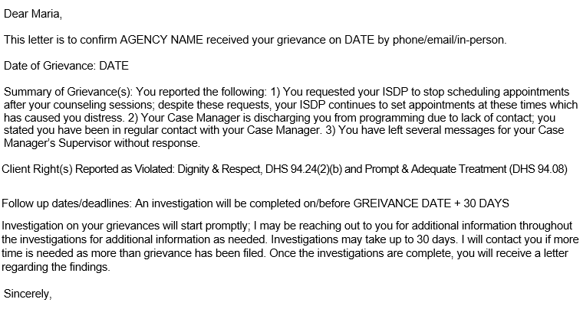
Grievance Confirmation Letter
Notes:
Make sure you note on the grievance confirmation letter that you will be contacting the client if more than 30 days is needed to complete the investigations due to having multiple grievances. You may email the letter but a paper copy must be mailed out. These letters are important because they put the grievance, reported client rights violations, and timelines in writing for you and the client to see. This also helps because it keeps us focused on the issues at hand and avoids investigating topics that are not within the scope of the grievance.

Slide 22
Investigations
Question:
What questions do you ask during an investigation?
Notes:
What questions do you ask during an investigation? Each investigation is different but for every grievance you should be asking 1) who was involved, 2) what happened, 3) where & did this occur and 4) what happened next? I also ask every person that files a grievance to send me any evidence or proof they have regarding their grievance.

Slide 23
Let’s Investigate Maria’s Grievances
1. Maria stated her Case Manager is disenrolling her from services due to lack of contact, but Maria states she has been in regular contact with her Case Manager.
Read provider notes from Case Manager
Interview Case Manager regarding contact with Maria
See if there are contact issues with others
Review disenrollment policy
Ask Maria to provide any evidence
Notes:
Let’s investigate Maria’s Grievances. The first grievance we are tackling is regarding her Case Manager. Maria stated her Case Manager is disenrolling her from services due to lack of contact, but Maria claims she has been in regular contact with her Case Manager. For the investigation, I would read provider notes from the case manager, interview the case manager regarding her contact with Maria, see if other providers are having issues regarding contact with Maria, and ask Maria to provide any evidence regarding her contact with her case manager.

Slide 24
Reviewing Notes
Read notes from Maria’s Case Manager
Look for any notes regarding missing/cancelling appointments, attempts to contact, texts, calls, emails, etc.
See if there are any contact issues with other providers
Notes:
If I am reviewing notes for an investigation, I usually read notes for a month or so before the date of the grievance. For Maria’s case, I would read notes entered by her Case Manager for the past couple of months. I would look for any notes discussing missed or cancelled appointments, attempts to contact, leaving messages, and sent emails and text messages, anything noting there was no response from Maria.

Slide 25
Interviewing the CM
Last contact/last face-to-face
Attempts to contact
Any additional information
Notes:
When interviewing her Case Manager, I would ask about the last time she had contact with Maria, when was the last face-to-face meeting, any attempts to contact, and if there is any additional information that is not in notes.

Slide 26
Evidence Provided by Maria
Things can be changed online
If evidence is being offered, asked to see if from the source
  Text messages, not printouts
  Phone logs, not printout
  Emails, not printouts
Notes:
: I always ask clients to provide any evidence that they have regarding the grievance. Often times, it’s their word against the worker but sometimes clients are able to provide emails, text messages, phone logs, or other documentation. Because we live in a world where documents can be changed. I ask to meet with the client and ask if I can see the actual text messages, phone logs, and emails on their phone. I have had a couple people tell me they have switched phones but most people gladly meet with me so I can see the evidence they are presenting. I met with one individual who provided me with months her phone bills that showed every incoming and outgoing call with the duration for each.

Slide 27
Burden of Proof
DHHS has a Grievance Process – Burden of Proof
Where a patient is sanctioned for a rule violation, the staff must show that it is More Probable Than Not (any amount of proof over 50%) that the patient violated the rule.
Where a patient claims wrongdoing on the staff’s part, the burden is on the patient to show that it is More Probable Than Not that the staff acted as alleged.
https://www.dhs.wisconsin.gov/clientrights/cgdd-gp-burden-proof.pdf
Notes:
Let’s take a moment to discuss Burden of Proof. If the client is sanctioned for a rule violation (like disenrollment from programming due to lack of conduct) then the staff member must show it is more probable than not, the client broke that rule.
If a client claims wrongdoing by a staff member (like lying about contact, or disregarding requests to meet on different days) then it is up to the client to show that it is more probable than not, the staff acted as reported.

Slide 28
Investigation
After reading notes, speaking with Maria’s case manager, other providers, and reviewing any proof Maria is able to supply, you should have good idea if lack of contact was indeed an issue or not.
If things are not adding up:
Look outside of the box
Consult with your team
Reach out to BHS CRS
Notes:
After reading notes, speaking with Maria’s case manager, other providers, and reviewing any proof Maria is able to supply, you should have a good idea if lack of contact was indeed an issue or not.
I had a complaint years ago that I based this example on. The client was leaving message after message for her Care Coordinator and every time her CC would try and contact her back, she would receive a message stating the call could not go through. This went on for months and everyone was frustrated. The client felt her CC was ignoring her and the CC felt the client was no longer interested in programming because she kept giving a number that not allow calls to go through. It turned out that the CCs cell phone, for some reason would just not call out to the client’s number, it was weird and no one even the cell phone provider could figure it out. This was 100% a technology issue that neither were aware of until a complaint was submitted.
If things are not adding up, look for unexpected explanations, consult with your team and as always, feel free to reach out to us.

Slide 29
Let’s investigate Grievance 2
Maria’s ISDP continues to schedule appointments on Tuesday & Thursdays after her counseling sessions, despite these requests not to.
Read provider notes from ISDP
Interview ISDP regarding appointment days
Ask Maria to provide any evidence
Notes:
Let’s investigate grievance 2. Maria’s ISDP continues to schedule appointments on Tuesday & Thursdays after her counseling sessions, despite these requests not to. For the investigation, I would read provider notes from the ISDP, interview the ISDP regarding discussions regarding appointment days, and ask Maria to provide any evidence regarding her requests about appointment dates with her worker.

Slide 30
Reviewing Notes
Read notes from Maria’s ISDP
Look for any notes regarding appointments dates, texts, calls, emails, etc.
Notes:
Again, I usually read notes for a month or so before the date of the grievance but for situations like this, you may need to go further back. I would read notes entered by her ISDP and look for any notes, noted texts, or emails regarding scheduling appointments or requests for appointments to occur on different days.

Slide 31
Interviewing the ISDP
Last several appointments – overall impression
When next appointments are set
Any additional information
Notes:
When interviewing her ISDP, I would ask about the last several appointments and Maria’s overall impression during those meetings – did Maria appear or express being stressed or overwhelmed? I would also ask when next appointments are set, if Maria has requested appointments be scheduled on other dates, and if there is any additional information we should know.

Slide 32
Evidence Provided
Review any evidence provided
Actual emails, text messages, phone logs
Notes:
Just a reminder, make sure any evidence that you are reviewing are originals. I have met with people and asked them show me things on their phone and so far 100% of them have been cool with it. If you do receive forwarded emails as evidence, you can ask the other people on the chain, if they are within your organization to send those to you as well.

Slide 33
Grievance 3
Maria stated she has left several messages with her Case Manager’s supervisor without response
Read provider notes or call logs from Supervisor (if available)
Interview Supervisor regarding calls
Review internal policies
Ask Maria to provide any evidence
Notes:
Maria stated she has left several messages for her Case Manager’s supervisor regarding her possible discharge without any calls back. For the investigation, I would read any provider notes or call logs from the supervisor, if those are available, interview the supervisor, review any internal policies regarding call back timelines or requirements, and ask Maria to provide any evidence.

Slide 34
Notes, Interviews, & Evidence
Read notes any notes from Supervisor
Review call logs & policies
Interview Supervisor – ask about calls/messages received and if they responded
Review evidence provided by Maria
Notes:
Read any notes written by the supervisor regarding calls/messages received and/or returned, review call logs, policies, and interview supervisor about any calls or conversations with Maria. When reviewing Maria’s evidence, make sure you are reviewing originals.

Slide 35
When Do We Speak to Maria?
Anytime we have questions
Whenever they call, text, or email
To confirm you received something
People like to know you are working on solving their problem!
Notes:
Okay, you may be asking when would we connect with Maria during the grievance process? I reach out anytime I have questions, whenever I receive an email, call or text, and if they send me any evidence, to confirm that I received it. People like to know you are working on helping them solve their problem.
When you speak to them to ask additional questions or check on something, it’s okay to let them know you have not finished the investigation yet, so a decision has not ready.

Slide 36
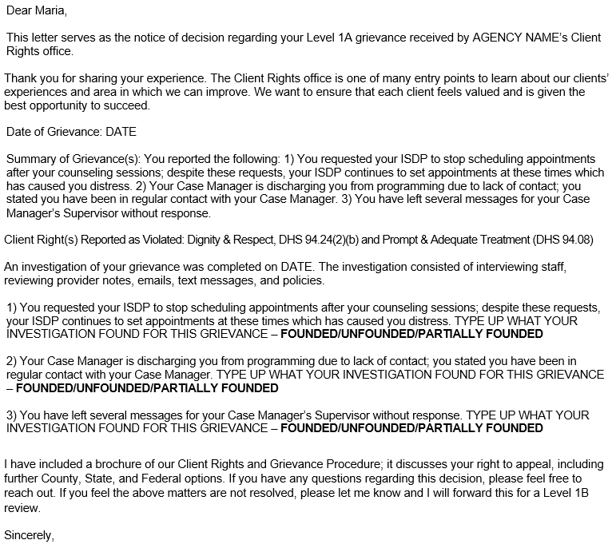
Decision Letter
Notes:
For your decision letter, try to spell everything out as clearly as you can and keep your language at a 5th grade level. We want this easy to understand. This letter should also be mailed so the client has something tangible with the decision. Your letter should also explain what steps need to be taken if the clients chooses to appeal the decision.

Slide 37
Decision
Include a CR brochure with your letter
CC to the Program Manager
You can call to explain the decision letter, findings & next steps
Even if things are not found in the client’s favor – still try to help solve the problem
Notes:
You should mail out a Client Rights brochure with your decision letter and CC your Program Manager. I also call people to review the decision letter, to make sure they understand it, and to discuss next steps; not everyone does this step and that’s okay. I recently spoke to someone who didn’t understand what founded and unfounded meant, a call helped me clear that up with them.
Let’s say Maria’s grievance against her ISPD was unfounded because she didn’t express to her worker her discomfort of having appointments after her counseling sessions. Even though a decision is unfounded, your agency should still do what they can to help resolve the problem or tackle the underlying issue through recommendations. We are here to serve, and we want to make sure people are getting the services they need.

Slide 38
Brochures
It is recommended that every letter you send out has the CR brochure added.
It reviews the grievance process
Has your CRS contact information
https://www.dhs.wisconsin.gov/library/collection/p-23112
Notes:
It is recommended that every letter you send out has the CR brochure added. The brochure goes over the entire grievance procedure, the different levels, timelines, and you can customize it to put your CRS info on it.

Slide 39
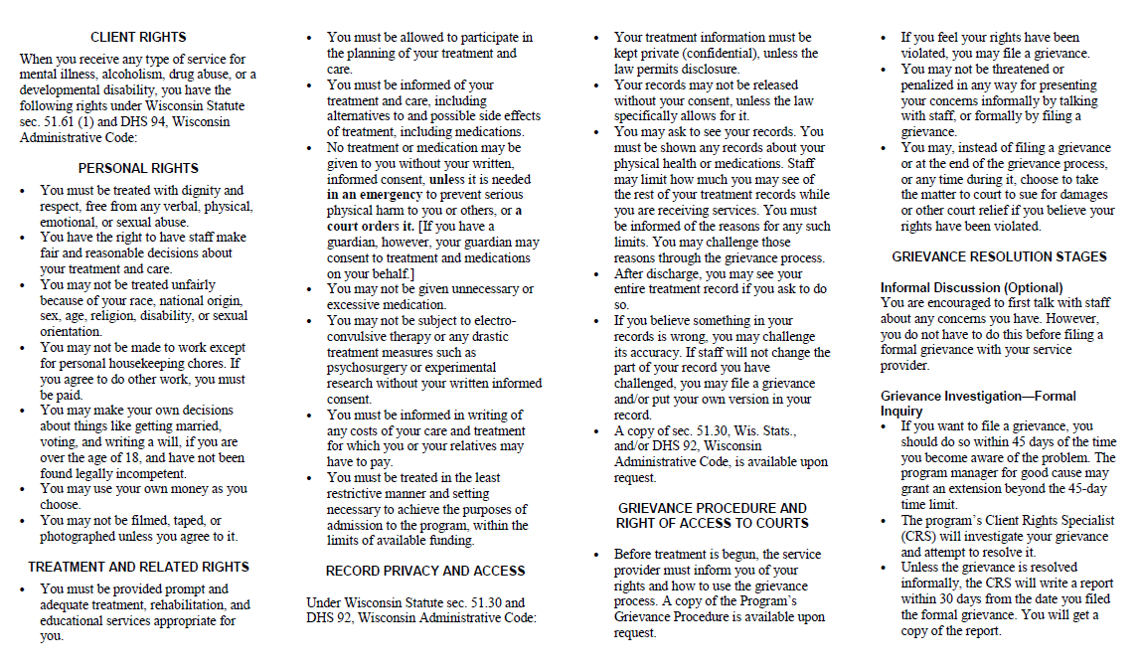
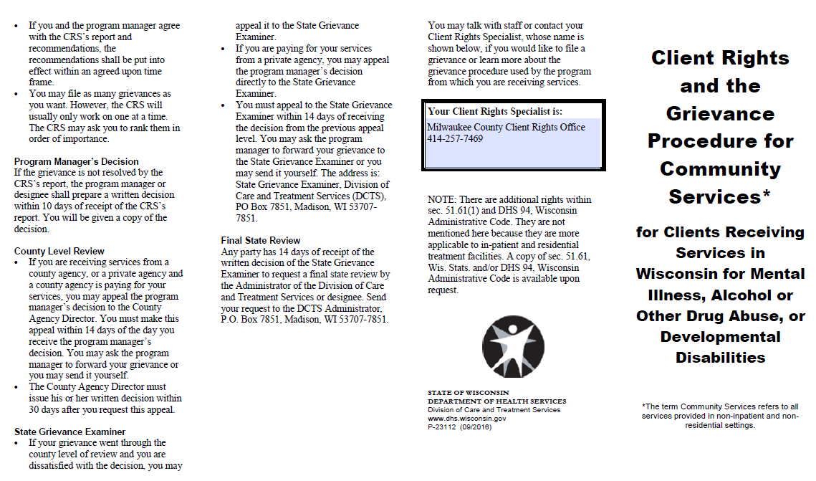

Slide 40
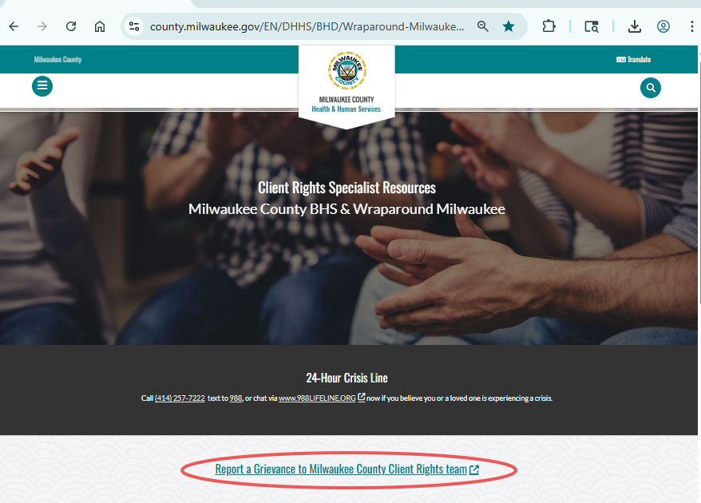
Reporting Grievances
Make sure your agency is reporting ALL Level 1A and Level 1B’s grievances on the CR Website
https://county.milwaukee.gov/EN/DHHS/BHD/Wraparound-Milwaukee/Provider-Portal/Client-Rights-Specialists
Notes:
Make sure your agency’s CRS is reporting all Level 1A and Level 1Bs on the CR website. We have only received 14 notifications since November, and I am concerned not all grievances have been reported. This is a requirement from the State.

Slide 41
Posters
Per DHS Requirements:
All of us are required to have at least one CR poster hung in our building, in a public facing area.
You can order posters at https://www.dhs.wisconsin.gov/clientrights/formspubsposters.htm
Notes:
DHS also requires that we all have at least one CR poster hung in our buildings and in a public facing area. At the Coggs Center, we have them in English, Spanish, and Hmong. You can order them free from the DHS site.

Slide 42
Questions
If you have any questions, please feel free to raise your hand or put your questions in the chat.
Please remember not to disclose any HIPPA protected info

Slide 43
Survey
Your input is important to us! Please fill out our quick survey!
How did we do?
What topic(s) would you like us to discuss at the next forum?

Slide 44

Thank you for all you do!
Grievances can be tricky. We are here to help! Please feel free to contact us if you have any questions or need support!
Milwaukee Co. Client Rights Line 414-257-7469
bhsclientrights@milwaukeecountywi.gov
Holly McElhatton & Vicki Orzel

