Slide 1
Client Rights Forum
Welcome!
August 5, 2026
9am to 10:30am

Slide 2
Agenda
Reporting Grievances
Critical Incident Reporting & Caregiver Misconduct
Burden of Proof
Examples
Boundaries/Conduct
Level 1A & Level 1B Review
Handouts and posters
Q/A

Slide 3
Reporting Grievances
Last fall it was announced that all Level 1A and Level 1B grievances must be report to the BHS Client Rights team (per State Guidance)
To date - 22 grievances reported
Concerned not all grievances are being reported as required
Notes:
Last fall the BHS Client Rights team received instructions from the State to track all of our provider grievances. This request makes sense, as the contract holder BHS is technically responsible, so we should be kept in the loop. Once we receive notice that a grievance has been reported, we reach out to that agency letting them know we are here for any questions or support because some grievances can be really tricky. I will reach out again on day 30 (or the next business day if that day falls on a weekend/holiday) for the Level 1As and 10 days for the Level 1B to ask the status of those grievances. As of today, only 22 grievances have been reported since November of last year. This number seems extremely low as we have thousands of BHS services recipients and hundreds of service providers.

Slide 4
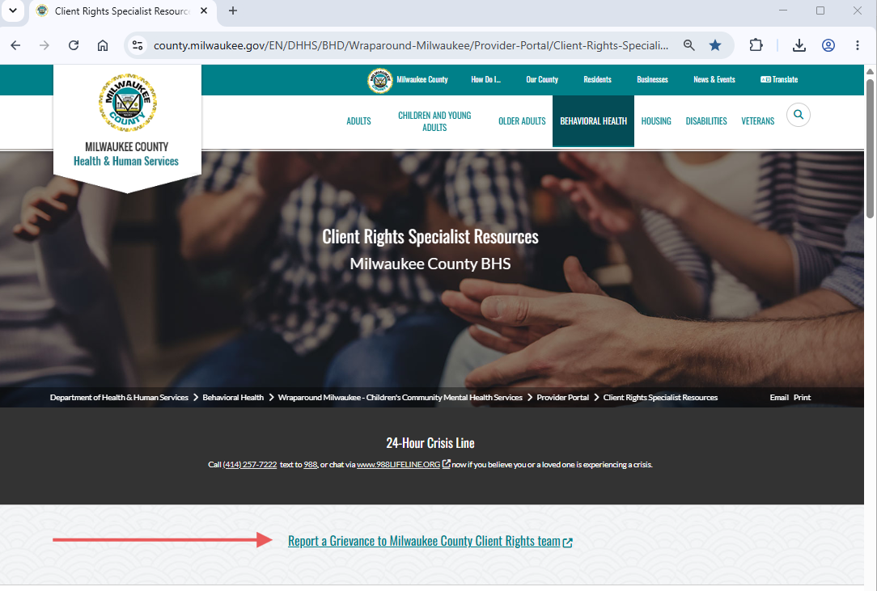
Reporting Grievances
https://county.milwaukee.gov/EN/DHHS/BHD/Wraparound-Milwaukee/Provider-Portal/Client-Rights-Specialists
Notes:
To report a grievance to the BHS Client Rights team, go to the county’s Client Rights Specialist page and click on “Report a Grievance to Milwaukee County Client Rights Team”. You will be brought to a quick form that will ask for your contact information, the name and MRN or DOB for the client, date of the grievance, if it’s a Level 1A or Level 1B and a brief description of the grievance. We do not need a ton of information for the description, just a couple of sentences of what the grievance is about. If you currently working on any grievances, that has not been reported, please make sure to report them today. We are asking agencies to report grievances as soon as a grievance is requested.

Slide 5
Critical Incidents
Critical Incidents can easily overlap with client rights
Everyone (providers & BHS/DHHS employees) is responsible for reporting any critical incidents to DHHS within 24 hours of becoming aware of the incident
DHHS Critical Incident Form
Notes:
Critical incidents and clients rights can easily overlap. Per DHHS policy, all providers and BHS/DHHS employees are required to report any critical incidents within 24 hours of becoming aware of an incident that is defined as a critical incident. This slide has the link to that online form.

Slide 6
DHHS - Critical Incident Policy
Abuse or neglect/Protective Services Contact
Caregiver misconduct
Law enforcement involvement
Unfavorable media exposure
Medication related events
Physical Injury
Restraint
Notes:
These situations require a Critical Incident but can also be a Client Rights violation depending upon the situation. Abuse, neglect, protective services contact is defined as any event that requires contacting child or adult protective services including abuse and neglect. Caregiver misconduct is any credible allegation of caregiver misconduct as per DHS Statue 13. Law enforcement involvement this is when law enforcement becomes involved due to an incident that jeopardized the physical or mental health, safety, and wellbeing of a recipient or staff member. Unfavorable media exposure this if for any event involving law enforcement or first responders that could result in unfavorable media exposure or publicity. Medication related events this is where use of a medication results some type of adverse outcome; it could be drug administration errors or drug reactions. Physical injury is where medical attention is needed. Restraint is any use of restraint of a service recipient and/or any injury by services recipient or staff during the use of restraint.
The critical incident policy has several other situations (like violence, fire-starting, sex trafficking, etc.) that require a critical incident to be reported, these examples listed above are the ones that I feel will overlap with Client Rights the most. I encourage everyone to review the Critical Incident policy if you have not read it recently.

Slide 7
Caregiver Misconduct
Incidents of caregiver misconduct can easily overlap with client rights
Everyone (providers & BHS/DHHS employees) is responsible for immediately reporting any witnessed or knowledge of possible alleged caregiver misconduct to their manager
Notes:
Caregiver misconduct is another area that overlaps with client rights. Per the Caregiver Misconduct policy, everyone is required to report any witnessed or knowledge of possible alleged caregiver misconduct to their manager. A caregiver is defined in the policy as a person who is employed or under contact with BHS/DHHS and has regular direct contact with BHS/DHHS Clients or the personal property of clients.

Slide 8
BHS – Caregiver Misconduct Policy
Abuse
  Includes restraint, isolation, confinement, sexual contact, forcible administration of medications, verbal/mental/sexual abuse, causes harm/pain/injury/death, or disregarding client rights under Chapter 50 or 51
Neglect
  Intentional omission or intentional course of action(s)
Notes:
Per the policy, abuse is the act or repeated acts by a caregiver, including but not limited to restraint, isolation, confinement, sexual contact, forcible administration of medications, verbal/mental/sexual abuse, causing harm/pain/injury/death, or disregard of client rights under DHS Statues 50 or 51. Neglect is intentional omission, intentional carelessness, or intentional course of contact by a caregiver including but not limited to restraint, isolation, confinement that is contrary to policies and procedures outlined by BHS, is not a part of the client’s treatment plan and causes or could cause pain, injury, death, mental or emotional damage to the client. Neglect does not include act(s) of mere inefficiently, unsatisfactory conduct, or failure in good performance as the result of inability or good faith errors in judgment.

Slide 9
Caregiver Misconduct continued…
Misappropriation of property
  Taking, carrying away, using/misuse, transferring, concealing or retaining possession of client’s movable property without consent
  Intentionally using or attempting to use personal identifying information
  Theft of money, credit cards, jewelry
Injury of unknown source
  Suspicious injury due to type or location of injury
Notes:
Misappropriation of property is defined at taking, carrying away, using/misuse, transferring, concealing, or retaining possessions of a client’s moveable property without consent. Intentionally using or attempting to use personal identifying information, theft of money, credit/dept cards, jewelry, and may include suspicious injuries.
I encourage everyone to review the Caregiver Misconduct policy if you have not read it recently.

Slide 10
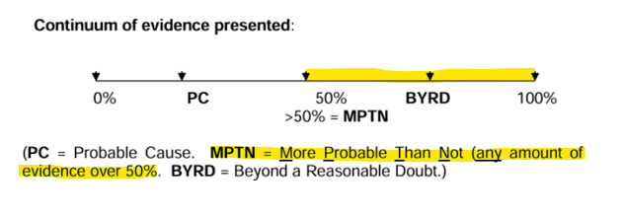
Burden of Proof
Burden of proof in the grievance process determines who has the responsibility for proving facts through testimony and other evidence and the amount of evidence that must be proven.
https://www.dhs.wisconsin.gov/clientrights/cgdd-gp-burden-proof.pdf
Notes:
Burden of proof determines who is responsible for proving facts and evidence for the grievance. Burden of Proof for our Level 1A investigations can be challenging and I think the chart on the DHS website can be confusing. The link on this side is for the DHHS Burden of Proof document; the state has a bunch of examples listed however the information on the examples are extremely limited. I have used the examples for more of a starting off point if I am doing research for a grievance.
Here’s what the chart means. PC or Probable Cause is when the evidence shows there is 25% or more probability that something occurred. Probable cause is only taken into account when the grievance is regarding security measures and staff hold the burden of proof for any grievances related to security measures. BYRD or Beyond a reasonable doubt is when evidence shows 75% or more probability. Beyond a reasonable doubt is only used by the State when showing a crime has been committed and criminal charges are involved. MPTN or More probable than not is where we need to focusing on.

Slide 11
Burden of Proof Continued…
More than 50% of the evidence = More probable than not
If a client is sanctioned for a rule violation, staff must show that it is more probable than not that the client violated the rule.
If a client claims wrongdoing on the staff’s part, the burden is on the client to show that it is more probable than not the staff acted as alleged.
Notes:
For our Level 1As and Level 1B reviews, the evidence must show 50% or more probability. If a client is sanctioned for a rule violation, the staff must show that it is more probable than not that the client violated that rule. An example of this could be if a client is discharged from services due to no contact for 60 days. If the client files a grievance for that discharge, the Staff would be responsible for showing evidence that the client was not in contact. Evidence could be notes on attempts to contact, messages left that were not returned, and/or missed appointments.
If a client is claiming wrongdoing on the staff’s part, the burden of proof is on the client to show that is it more probable than not the staff acted as alleged. A good example of this is if a client asked their Case Manager to make a referral for a specific service/provider and months later the referral was not made. Evidence could be text messages, the community treatment plan, or statements from other workers who were there when the original request was made.
Burden of proof is important because it gives a standard to base our decisions on. I often discuss burden of proof with clients so they understand if the burden lays on them and that we are looking beyond their word against their workers.

Slide 12
Evidence Examples
Provider notes
Emails
Witness Accounts
Policies/Procedures
Text messages (viewed from phones)
Police reports
Phone logs
Pictures
Notes:
Here are some examples of evidence to keep in mind during your investigations. Provider Notes: all off our clients have a right to their Community Provider Notes because there are a part of their medical record. Clients just need to do a records request with BHS Medical Records. Policy states that notes should be entered within 3 days of service, if I am reviewing notes for a grievance and notes are entered in weeks after a service is completed, I will question the notes because it is hard to remember details of a conversation weeks after it occurred. Emails, witness accounts, policies/procedures, texts, police reports, phone logs, and pictures can all be used as evidence. If you are using emails and text messages as evidence, make sure to view the emails/text given to you from the client and compare them to emails/text sent to/from your staff to ensure nothing has been changed.
Rely on your policies and procedures. I often quote policies and procedures in my decision letters so clients can see why decisions on their grievance was made a certain way. This also shows that everyone is held accountable to the rules.

Slide 13
No One Listens to Me
Someone wants to file a grievance because they feel their worker(s) does not acknowledge their needs/concerns
Possible client rights violation – DHS 94.08 Prompt & Adequate Treatment, depends upon the situation.
    Has been asking for a reasonable accommodation without action/response – Grievance
    Has been making requests outside the scope of services with/without response – not a grievance
    Burden of proof is on the client
Notes:
Let’s go over some examples. A common call that we receive is when someone expresses that no one is listening to their needs. This could be a possible client rights violation under DHS 94.08 Prompt and adequate treatment, it really depends upon the situation. If the client has been asking for a reasonable accommodation without action or response, like switching weekly appointment from one day of the week to another, this may be a grievance. I am saying may be a grievance because it is up the client if they want to go through the grievance process.
If a person has been making requests outside the scope of services, like asking for a daily home visits because they are lonely and like to chat, this is not a grievance. If the grievance is regarding services issues, the burden of proof is on the client.

Slide 14
Hugging
Someone wants to file a grievance because their worker hugs/hugged them
Possible client rights violation – DHS 94.24(2)(b) Respect & Dignity, depends upon the situation.
    When they cried, did not ask them to stop, doesn’t like to be hugged, has not occurred since – Informal
    At the end of every appointment, does not feel it’s appropriate for their worker to hug them – possible Grievance
    Alot, long hugs, feels intimate – Grievance & caregiver misconduct
    Burden of proof is on the client for grievance
Notes:
Hugging – I added this example because it recently came up in a complaint and I think this is a topic that we should be discuss. Someone wants to file a grievance because their worker hugs/hugged them. This could be a possible client rights violation under DHS 94.24(2)(b) under Humane psychological and physical environment, under the respect and dignity section, but it depends upon the situation. If someone was hugged by their worker once as a comfort, because something stressful or sad occurred, like the loss of a loved one, and the person did not ask them to stop or say it did not want to be hugged, this would be an informal resolution. Talk to the worker about how this person called about boundaries.
If a worker hugs the participants at the end of every appointment, the client called your to report that does not feel appropriate for their worker to hug them. This may be a grievance. Ask if the person expressed they do not want to be hugged because that could be an issue too, talk to the worker about not hugging their participants, and see if an informal resolution can reached, but the person wants to proceed with the grievance procedure, then that is their right.
If a person says their worker hugs them a lot, long hugs, and it feels intimate. This may be a grievance but it is definitely a caregiver misconduct that should be reported to your manager asap. Remember your sexual harassment training, it is how the person perceives the contact, not the intent of the contact. We work in a field where people share things about life and their mental health that some people do not feel comfortable discussing with their family or friends. We need to be extremely mindful of our interactions with those we serve. We need to continue to be supportive and empathic but make sure we are being professional and respecting other’s boundaries as well.
The burden of proof for the grievances is on the client for this grievance example. The caregiver misconduct report is separate and independent report.

Slide 15
Rudeness/Disrespect
Someone wants to file a grievance because they feel their worker is rude; stated they were disrespected.
Possible client rights violation – DHS 94.24(2)(b) Respect & Dignity, depends upon situation.
    Worker purposely uses the wrong pronouns – Grievance
    Client called 6x on Monday, worker only them called back 1x or did not call back until Tuesday– complaint
    Client says worker hung up on them – maybe (more info needed)
    Burden of proof is on the client
Notes:
Another common call we receive is when someone wants to file a grievance because their worker was rude or disrespectful. Rudeness could be client rights violation under DHS 94.24(2)(b) respect and dignity section, but it depends upon the situation. Some people may feel a specific situation is rude or disrespectful while others may not.
If a worker is purposely using the wrong pronouns, that may be a grievance. If a client calls and leaves a ton of messages and the worker only calls the client back once, that is a complaint. Every agency should have a policy/procedure regarding client contact and timeframes they can refer to and share with clients. Best practice for the county is to call clients back the same or next business day.
If a client says their worker hung up on them, more information is needed. This could possibility be a grievance or a bad connection or it could be follow through after the worker told the client the call would be ended if they continued to swear at them or call them names. Burden of proof is on the client.

Slide 16
Boundaries/Conduct
It’s okay to create policies that outline expectations for our clients.
Excessive calls
Abusive/sexual/inappropriate behaviors
Threats/aggression
Sober participation
*Keep in mind the population were are working with
Notes:
The last example was a good segway to our discussion on boundaries and conduct. I often make recommendations to agencies to create policies/procedures regarding client expectations and conduct. I do this because it is important for our clients to understand what is expected of them during their participation, but we also need to protect our workers just as much as we protect our clients. These policies should cover things like excessive calls, abusive, sexual and other inappropriate behaviors, threats or aggression, and sober participation. Just make sure to keep the population we serve in mind while making these policies and that your agency policies aligns with BHS policies/procedures and your contract requirements.

Slide 17
Level 1A Review
Someone wants to file grievance
  Complaint or grievance (was a client right violation reported)
  Did the incident(s) occur within the last 45 days
  Does the person want to go through the formal process
    How do they want this resolved? Can it be informal?
Mail and/or email grievance confirmation letter
  You may want to verify they received
Report Level 1A on Client Rights website
Notes:
Next, we are going to quickly run the processes and timelines for grievances. Someone contacts you and wants to file a grievance. First, we need to determine if it is a complaint or a grievance. Remember a grievance requires a reported client rights violation and the client needs to be willing to go through the grievance processes. An informal resolution should be discussed first and could be the solution to solving their problem immediately. Did the event or incident occur within the last 45 days? If the incident they are contacting you about occurred more than 45 days, there has to be a good reason for the delay in them contacting you; like they just found about the situation they are calling you about, new information has been discovered, or if they expressed they were afraid to contacting you would affect services. Once it has been determined to meet the criteria of a grievance, a grievance confirmation should be sent. This letter can be emailed but it is recommended that you mail it too so they have a tangible copy. These letters are important because it will list all of the topics for the grievance and notes deadlines. The person filing the grievance may contact you if items they wanted addressed in the grievance were not listed on the letter so you may want to verify that they received it. Make sure you report the Level 1A Grievance on the Client Rights website.

Slide 18
Level 1A Review (1/2)
30 days to complete the investigation
  Interview(s) those involved, gather & review evidence
    Only investigate incidents addressed on the grievance confirmation letter
    Additional concerns will need another grievance or can be addressed informally
  Can request an additional 15 days to complete the investigation, if needed
Notes:
You will have 30 days to complete the investigation for the Level 1A. It is important to review any evidence provided by the person filing the grievance and reach out to everyone involved to get their account of the situation. Make sure you are only investigating items you listed on the grievance confirmation letter and not adding any additional items. They cannot keep adding topics to the grievance, if they had additional things they want added, they should look at filing another grievance or informal resolutions for these topics. If the investigation is taking longer than planned, you can request an additional 15 days with the client. If they do not agree with the time extension, try to come up with an informal resolution for the additional time. The Statue is not very specific about what should occur if someone states they will not accept the time extension; I guess they will have an incomplete investigation and/or findings or will have to wait for the investigation to be completed.

Slide 19
Level 1A Review (2/2)
Mail (required) decision letter
  Briefly describe investigation methods
  Finding(s) & reasons behind findings
  Next steps (Level 1B)
  Recommendations (if any)
Client has14 days to appeal from the date they received the decision letter
Document everything in your Client Rights tracking system (not in Avatar)
Notes:
Once you made a decision on the grievance, you must mail out your decision letter. Mailing the letter is a requirement for DHS 94. Personally, I mail and email a copy of the decision letter. Make sure your letter briefly describes your investigation methods, findings, reasons for your findings, next steps if they choose to appeal, and any recommendations. The client has 14 days to appeal the decision from the date they received the letter in the mail. Make sure you document your investigation and client contacts in your Client Rights Tracking system. Remember, your client rights information should not be documented in Avatar as Avatar is for medical records only.

Slide 20
Level 1B Review (1/2)
Someone wants to appeal their Level 1A decision
  Was the Level 1A decision letter rec’d more than 14 days
Report Level 1B on Client Rights website
Program Manger has 10 days to review the Level 1A investigation
  Review the entire investigation, do not start a new investigation
  New items/complaints cannot be added
  Only review items appealed/addressed on the grievance decision letter
Notes:
If someone chooses to appeal the decision for their Level 1A grievance, that grievance moves to a Level 1B. If the grievance was requested more than 14 days after the client received the letter, you do not have to continue with the appeal process. Keep in mind, we are not sure how quickly or slow people receive their mail, so I extend this a few extra days. I would not go more than 20 days from the date of the letter. Once you are notified that someone wants to do a Level 1B grievance, make sure you report the grievance on the client rights website. A level 1B is a Program Manager review of the Level 1A investigation; this is not a new investigation. No new items or topics cannot be added to the grievance; only address items listed on the Level 1A decision letter. The program manager has 10 days to complete this step.

Slide 21
Level 1B Review (2/2)
Mail (required) decision letter
  Reasons why decisions remained the same and/or were overturned
  Next steps (Level 2 County Level)
    BHS Client Rights Team, 1230 West Cherry St., Milwaukee WI, 54205 414-257-7469 or bhsclientrights@milwaukeecountywi.gov
Client has14 days to appeal from the date they received the decision letter
Document everything in your Client Rights tracking system (not in Avatar)
Notes:
Once the program manager review is complete, they will mail out their decision letter. Mailing this decision letter is again required. The letter should review the reasons why the decision(s) from the Level 1A grievance remain the same or should be overturned. The letter should also discuss next steps if the person decides to appeal. Please make sure to put our information on the letter for who the client should contact if they choose to appeal this decision. Make sure you document everything in your client rights tracking system.

Slide 22
Handouts & Posters
Every agency is required to have Client Rights posters and brochures in their public facing areas.
Brochures are available in English, Hmong, Karen, Somali & Spanish
https://www.dhs.wisconsin.gov/library/collection/p-23112
You can order posters off the DHHS website
https://www.dhs.wisconsin.gov/clientrights/formspubsposters.htm
Notes:
Per DHS 94 all of us are required to have client rights posters and brochures in our public facing areas. Brochures are available in English, Hmong, Karen, Somali and Spanish. I recently had to get a brochure printed in Braile, if you are in need for something printed in Braile, let me know and I will send you the name of the company we had that printed through. This slide has the links for the posters and the brochures.

Slide 23
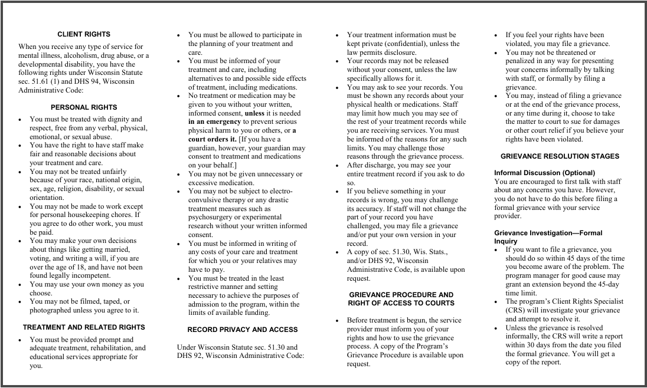
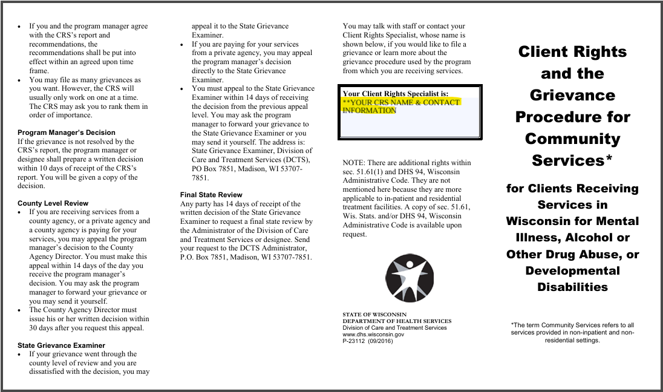
Brochures & Handouts
Notes:
Make sure you are putting your client rights specialist’s information on your posters, brochures and handouts. Please do not put down our information on your posters, brochures, and handouts.

Slide 24
Your CRS Info
If you have a change in your primary or back up Client Rights Specialist:
Send us their names, phone number, and email
Notes:
If your agency has any changes with your primary or back-up client rights specialist, please let us know 3 days. We will need their name, phone number, and email address. This information is needed for referrals and ensure they are included on our meeting invites and emails.

Slide 25
Next Forum
November 10, 2026
9:00am to 10:30am
TEAMS invite to be sent out in September
*Attendance for this forum is optional but
everyone is encouraged to attend.

Slide 26
Questions
If you have any questions, please feel free to raise your hand or put your questions in the chat.
**Please remember not to disclose any HIPPA protected info

Slide 27
Survey
Your input is important to us!
Please fill out this quick survey (link in the chat)
How did we do?
What topic(s) would you like to discuss at the next forum?

Slide 28
Thank you for all you do!
Some grievances can be challenging. We are here to support you and your team! Please feel free to contact us if you have any questions or need any guidance.
Milwaukee Co. Client Rights 414-257-7469
bhsclientrights@milwaukeecountywi.gov
Holly McElhatton & Vicki Orzel

Slide 29
Milwaukee County

